Slide 1
Sustainable Agriculture for Poverty Reduction in Marginal Environments
International Center for Biosaline Agriculture
September 24th, 2014

Slide 2

ICBA : Agriculture for Tomorrow
Vision:
To be the global Center of Excellence for innovative agriculture in saline and marginal environments.

Slide 3
ICBA : Agriculture for Tomorrow
Mission:
To work in partnership to deliver agricultural and water scarcity solutions in marginal environments.

Slide 4
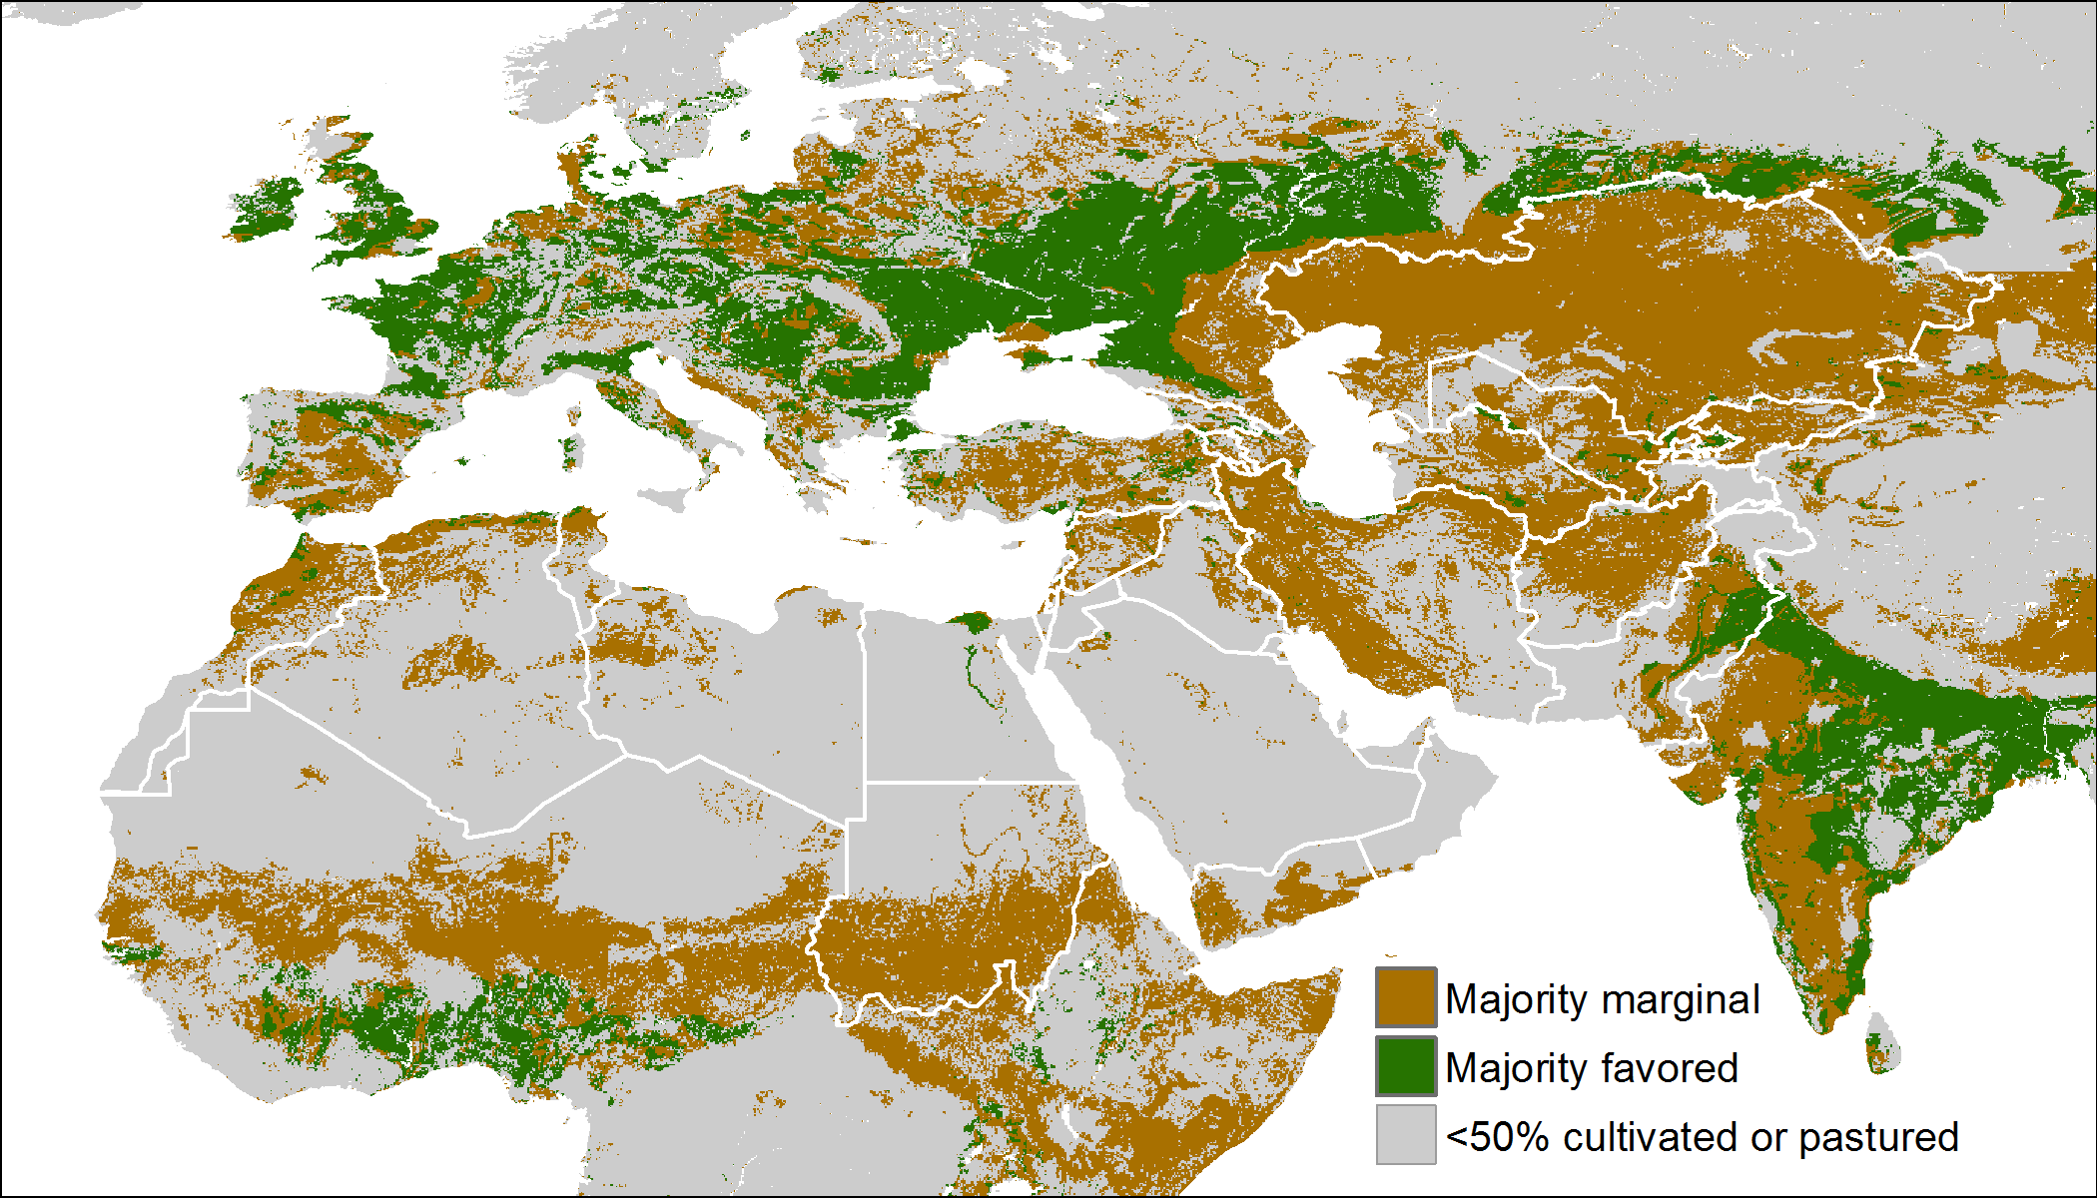
Why Marginal Environments are important?
Notes:
Land degradation and depletion of natural resources combined with the impact of climate change and a growing population, innovative thinking about sustainable management of both high potential areas as well as marginal environments.
To produce the food required for a 9.1 Billion by 2050, we will have to increase agricultural production in marginal environments
Increasing global population- require

Slide 5
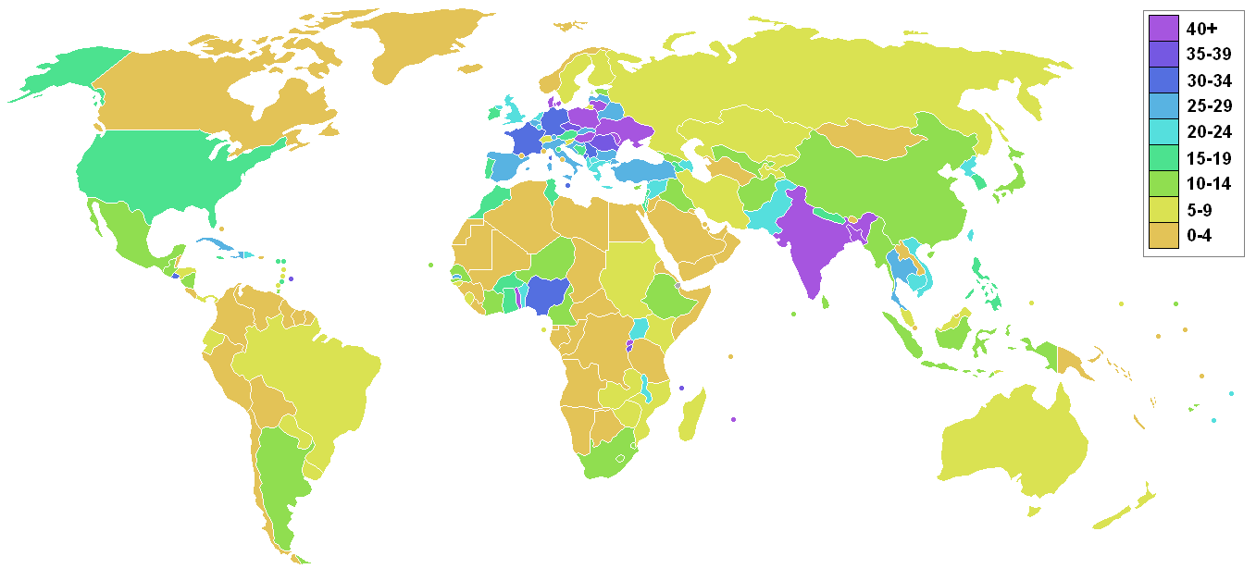
Arable land & Land Degradation
Arable Land in %

Slide 6
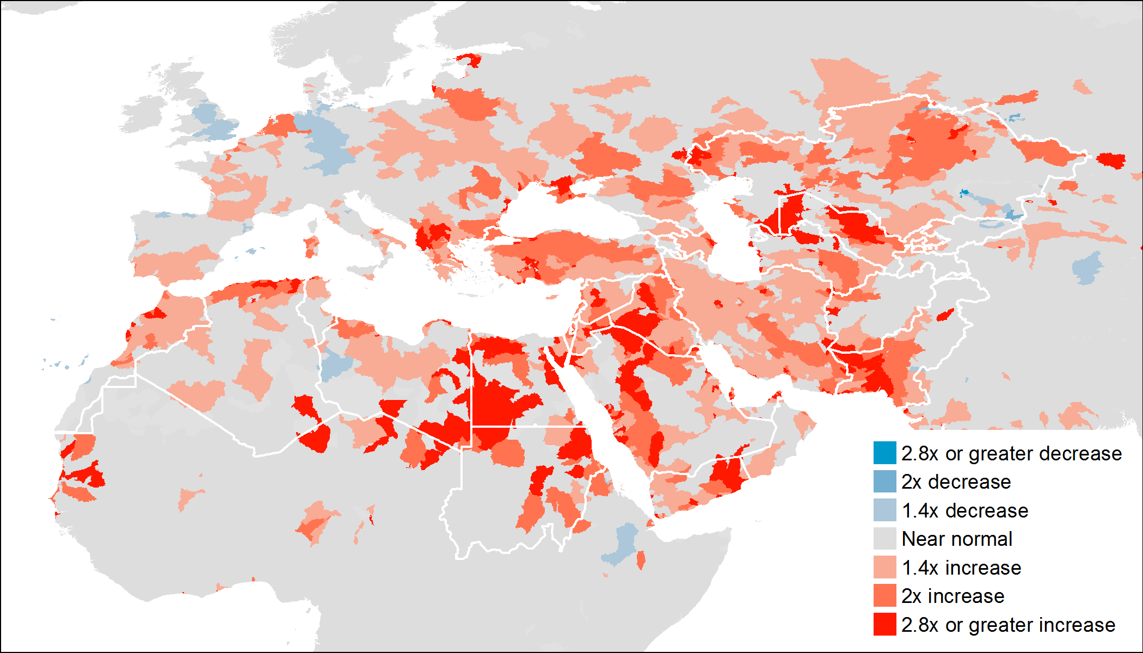
Projected change in water stress by year 2030 in high emissions scenario

Slide 7
Strategic Objectives
Strategic Outcomes
Strategic Objectives
Increased Food and Nutritional Security
More Resilient Environment and Income
Improved Water Security
Improve generation and dissemination of knowledge (knowledge hub)
Expand food and bioenergy solutions
Facilitate competitive agri-business enterprises
Increase and enrich partnerships
Notes:
Strategic Objectives
To improve the knowledge on food, forage, fuel and fiber that will benefit people dependent upon marginal environments and position ICBA as a bridge and broker for existing and new knowledge (knowledge hub)
To expand food and bioenergy solutions suitable for marginal environments
To facilitate the creation of competitive agri-business enterprises in marginal environments
To increase and enrich partnerships that support research for development in marginal environments
Solve today and tomorrow’s problems in marginal environments

Slide 8
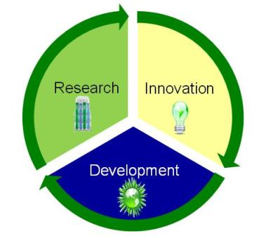
Methodology
Work through
Partnerships
to achieve Impact
Notes:
“Agricultural and water scarcity solutions in marginal environments delivered through partnerships to help achieve global food and nutrition security”
Working on a wider array of crops, the range of saline water, and inclusion of bioenergy in our research program
Working with partners to ensure that research is relevant, useful and is accessible, available and applicable.
Working on a wider array of crops; the range of saline water, and inclusion of bioenergy in our research program
Working with partners to ensure that research is relevant, useful and is accessible, available and applicable

Slide 9
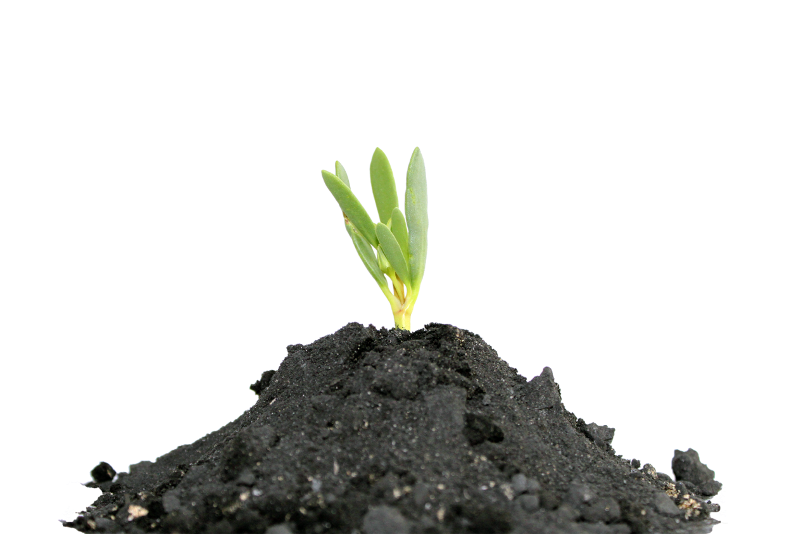
Research Innovations
Assessment of natural resources
Climate change impacts and management
Crop productivity and diversification
Aquaculture and bioenergy
Policies for resilience
Notes:
Assessment of NR – water, land, biodiversity
Climate change - Adaptation to climate change, assessment of water resources availability, variability and impact using modeling, GIS and remote sensing, scenarios of climate change impact for policy and decision making
Crop productivity e.g.
Stress-tolerant crops: salinity, drought, and marginal environments
Introduce new and alternative varieties of nutritious crops
Provide best practices in land management, technical support, and advice
Use of alternative water
Hydroponics
Biotechnology
Plant genetic resources
Aquaculture and bioenergy – integrated aquaculture/agriculture using saline water; salinity resistent bionergy crops e.g. Salicornia
Policies for resilience e.g.
Technical assistance to develop strategies and frameworks
Analyze policies and conduct socioeconomic studies on food and nutrition security; water and land management
Assess opportunities for value adding to market chains

Slide 10
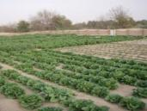
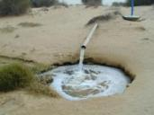
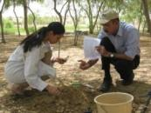
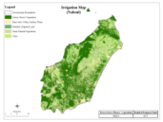
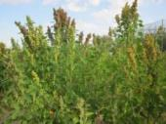
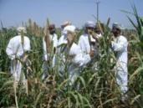
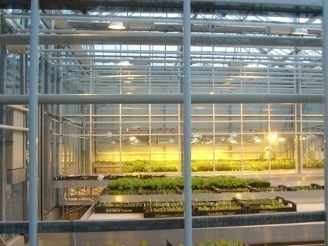
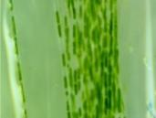
Key Technologies and Products
Irrigation technologies & management
Land management technologies
Modeling, remote sensing
Use of alternative water
Best Management Practices
Hydroponics & Aqua-ponics
Alternative Crops
Biotechnology
Notes:
Scope of our work covers:
Irrigation technologies and management: to improve water use efficiency and water productivity
Use of alternative waters: continue with saline water and expand research to the use of treated waste water in agriculture and landscaping
Hydroponics
Land management technologies: from soil information and mapping, fertilizer use, compost use, and salinity management to agronomic/land zoning
Best management practices: evaluate and adapt crop, soil, and water management practices to enhance productivity in marginal environments
Modeling, remote sensing and databases: Climate, water and crop simulation scenarios for coping with drought and adaptation to climate change
Biotechnology: the creation of crop varieties that will be productive and resilient in harsh conditions
Alternative crops for marginal environments: Salt-tolerant crop alternatives, plant genetic resources, Biofuel

Slide 11
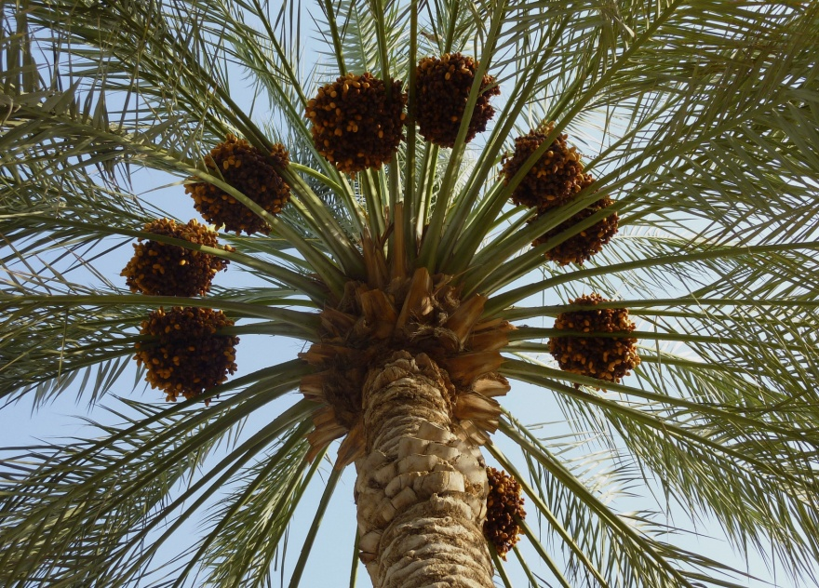
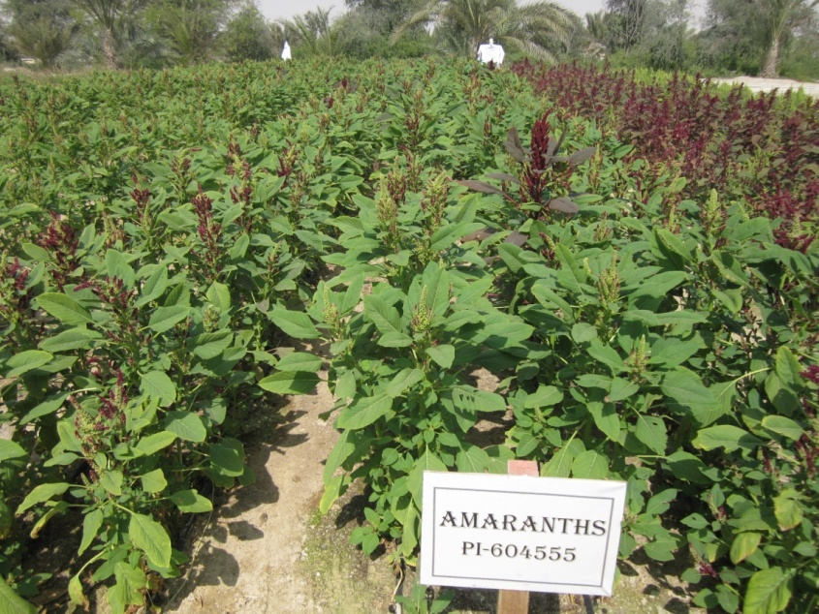
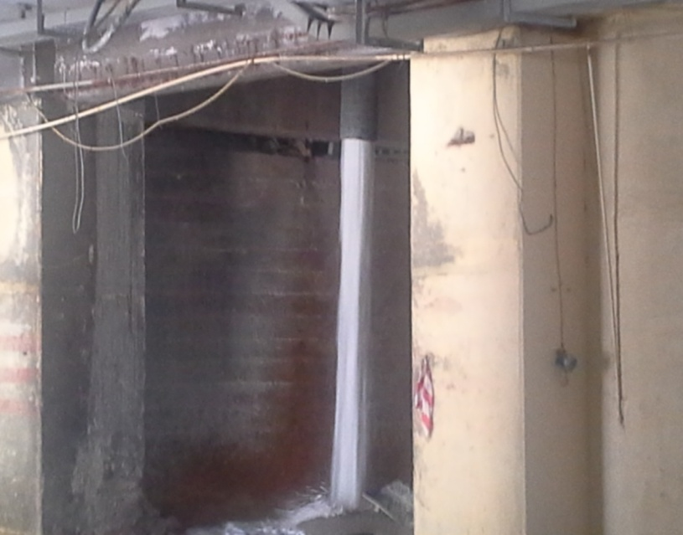
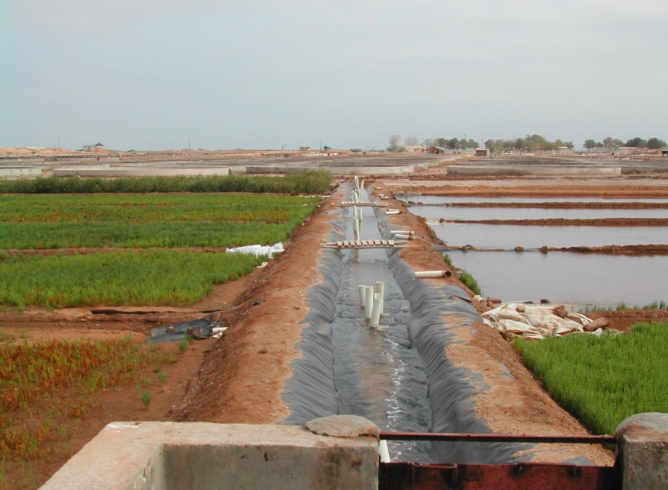
Use of Alternative Water
Water Security
Income Security
Treated Wastewater
Brackish Water
Reject water from mining
Sea Water

Slide 12
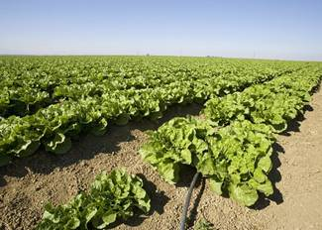
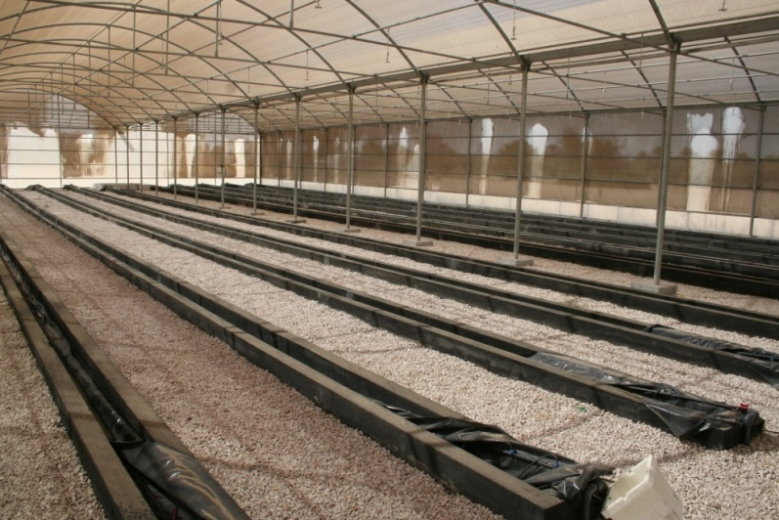
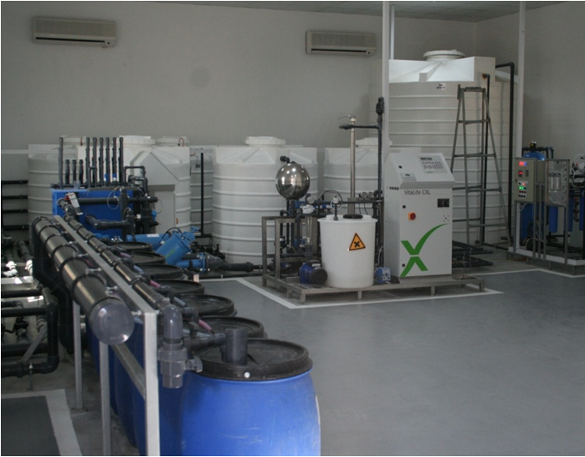
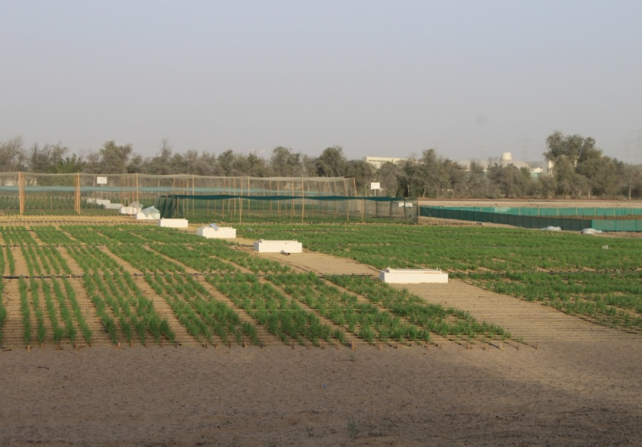
Irrigation Technologies & Management
Water Security
Sub-surface irrigation
Hydroponic protected agriculture
High technology greenhouses
SCADA System
Notes:
Sub-surface irrigation – can reduce water use by 20% compared with surface irrigation.
Hydroponic protected agriculture - lower water, pesticide and herbicides use.
High technology greenhouses would increase production and save water.
SCADA System is a powerful tool for improving irrigation management

Slide 13
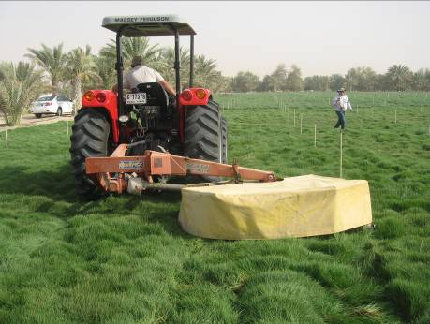
Land Management Technologies
Food Security
Nutrition Security
Water Security
Income Security
Model Farm Approach
For sustaining agriculture in marginal environment
Testing new technologies and crops
Dissemination and knowledge hub platform
Notes:
Managing Salinity in MENA and CAC Regions
Evaluation, introduction and adaptation of salt-, heat- and drought-tolerant system
System Approach for better Land Management

Slide 14
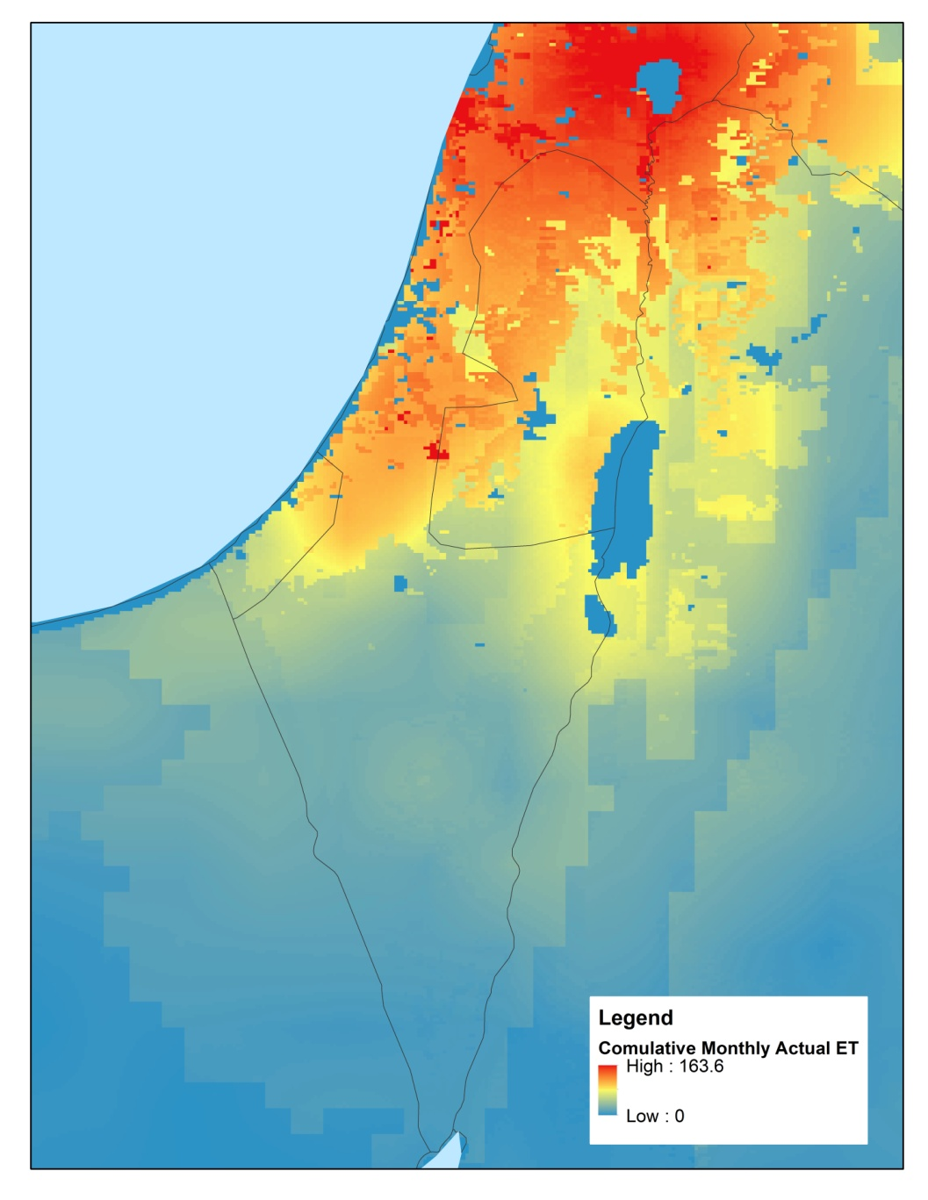
Modeling, Remote Sensing
Empower decision-makers to manage food and water security under the changing climate conditions through providing up-to-date data for:
- water,
- crop,
- climate data

Slide 15
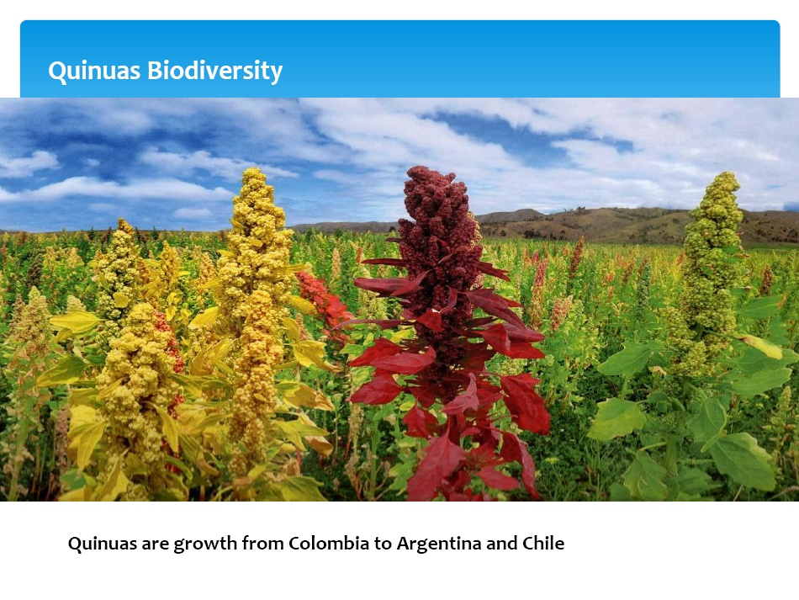
Alternative Crops
Food Security
Nutrition Security
Water Security
Quinoa
Notes:
New salt-, heat -and drought-tolerant crops
Alternative Crops:
Quinoa
sorghum
Pearl Millet
Salicornia
…. are productive in marginal environments

Slide 16
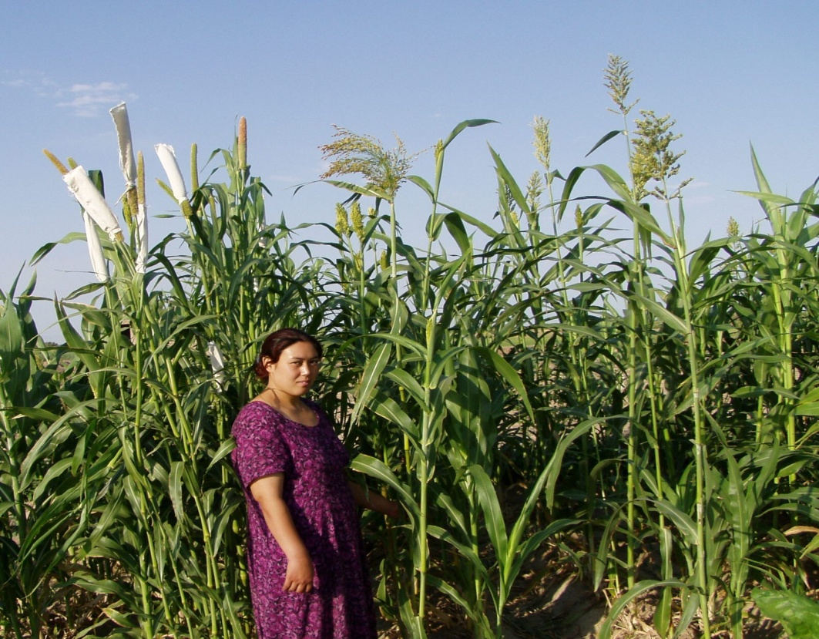
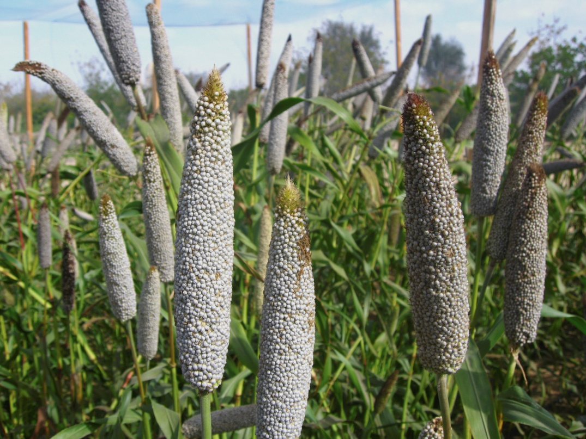
Alternative Crops
Food Security
Water Security
Sorghum
Pear Millet: Hashaki 1
Notes:
Sorghum and pearl millet were introduced in cotton and maize farms affected by salinity
Over >5 years, a number of varieties were tested under different salinity conditions and expanded to 150 farms
New variety of Pearl millet released -
Another variety of sorghum to be released shortly
…. are productive in marginal environments

Slide 17
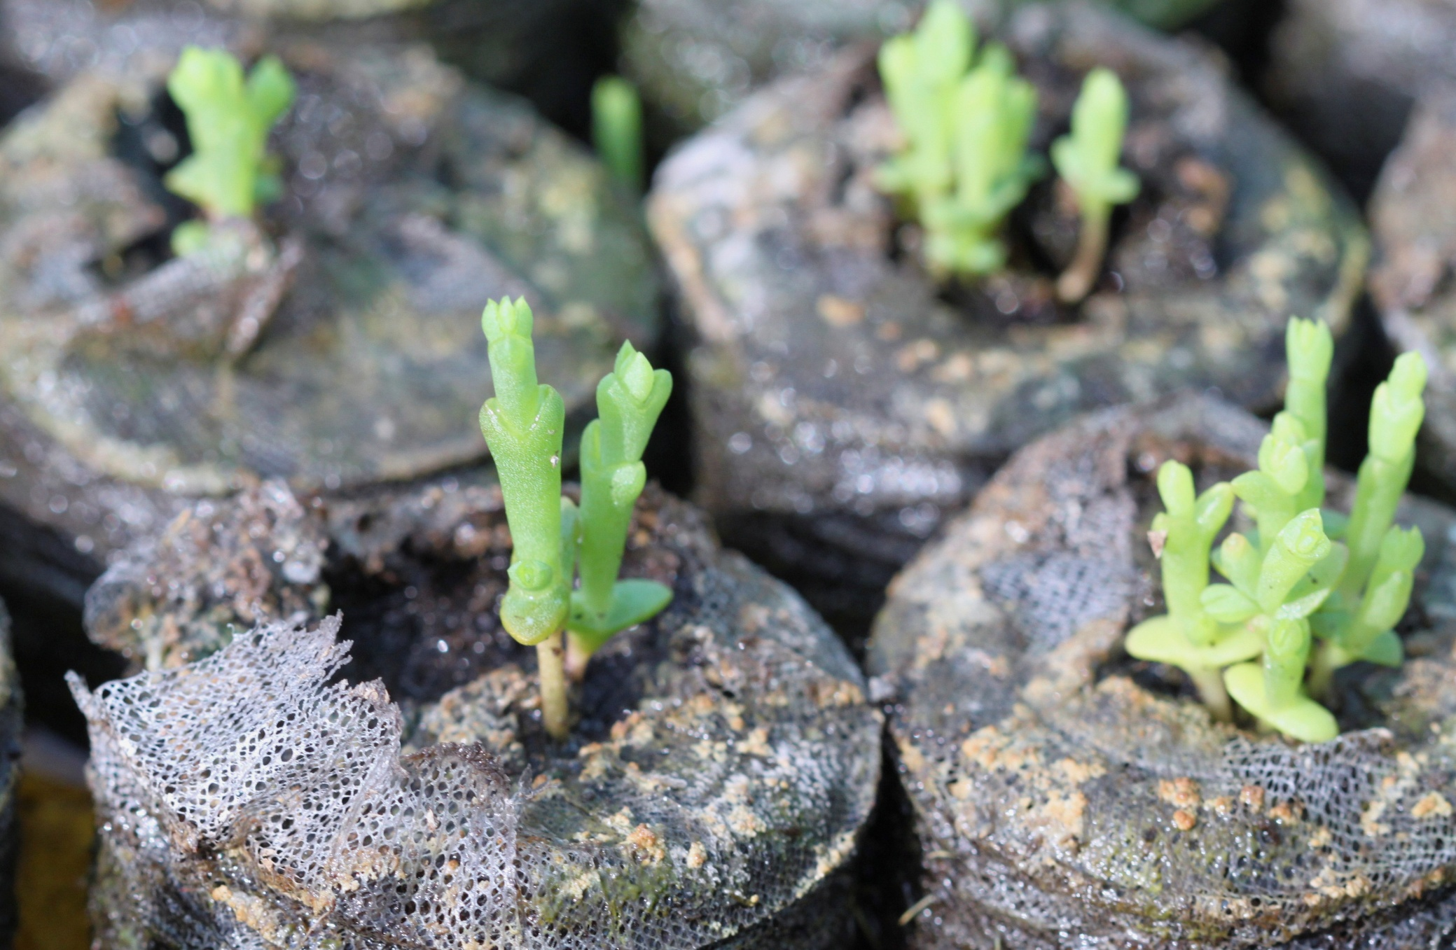
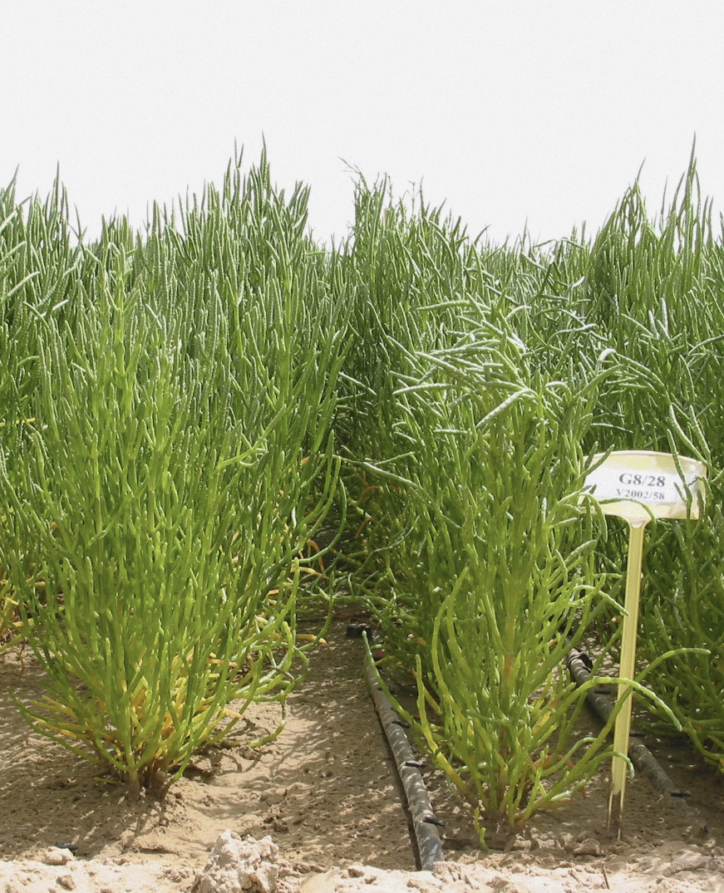
Alternative Crops
Income Security
Salicornia

Slide 18
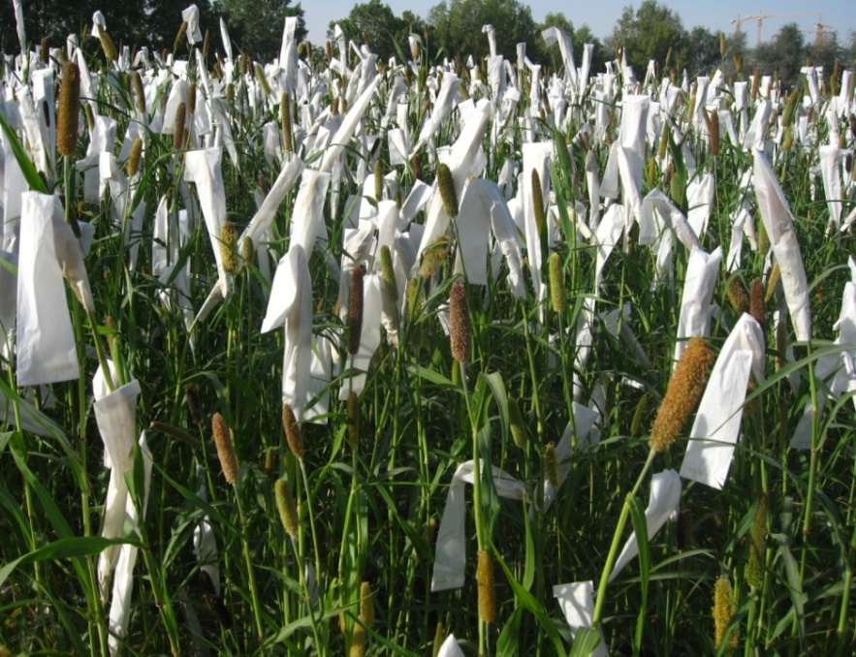
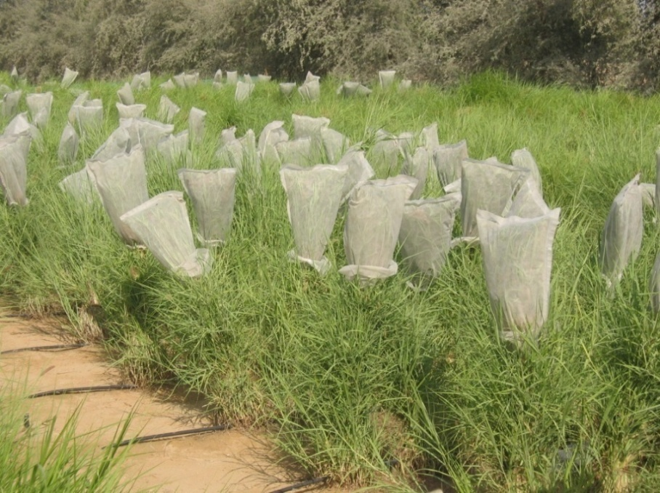
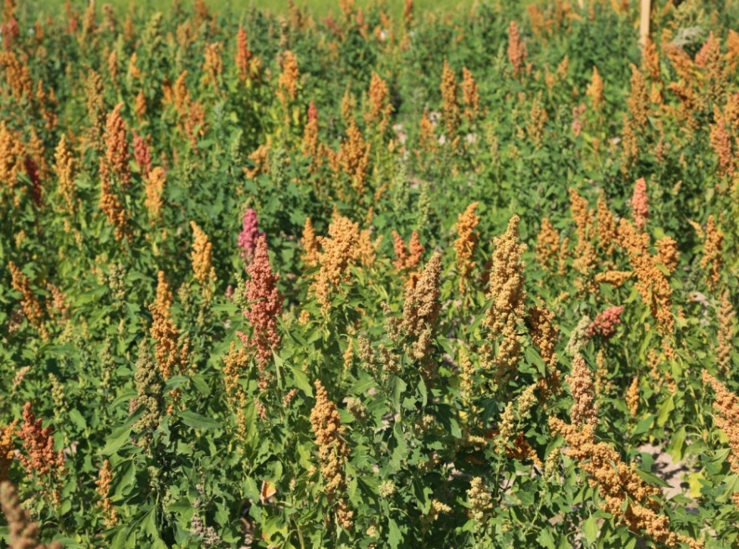
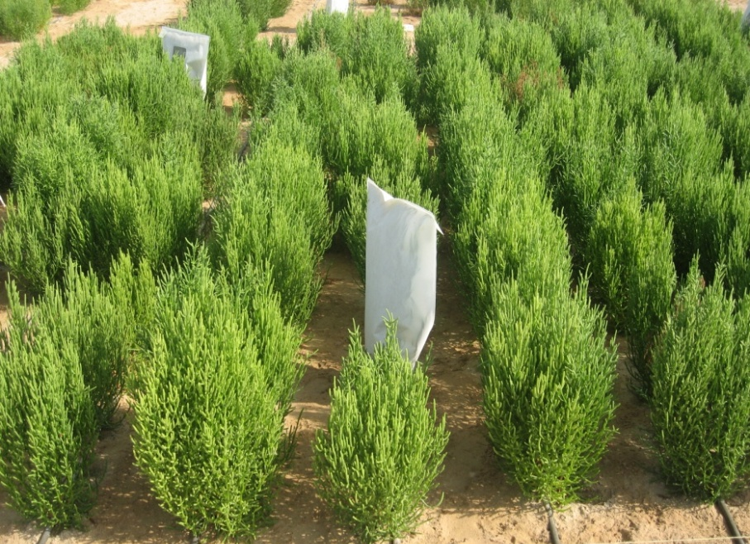
Seed Production Best Management Practices
Seed production is a challenge in marginal areas
Notes:
Seed production is a challenge in marginal areas for:
Demand by farmers
Non-availability of non-conventional crops and forages
ICBA has introduced seed production for all of its R4D projects for scaling-up
Yemen (60 ha)
Egypt (250 ha)
Syria (120 ha)
Oman (2 large farms)
CAC (100 ha)

Slide 19
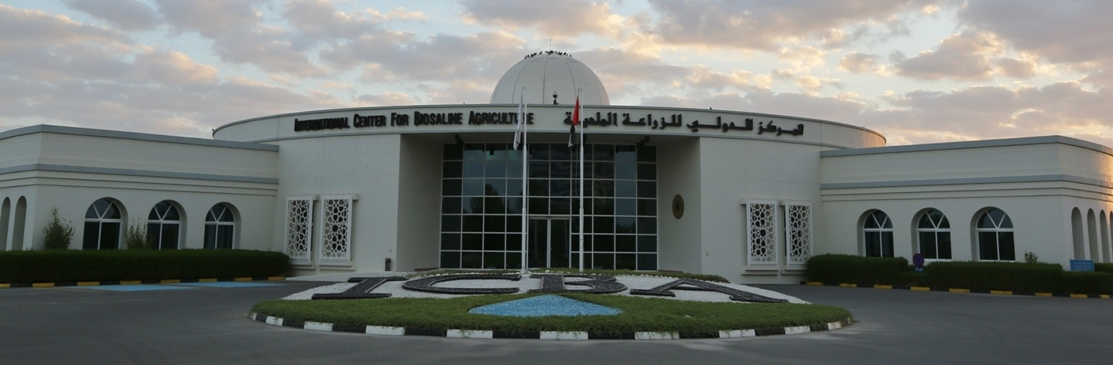
A unique Center of Excellence looking at Agriculture for Tomorrow
Thank you
For more information and ICBA publications visit www.biosaline.com

