Slide 1
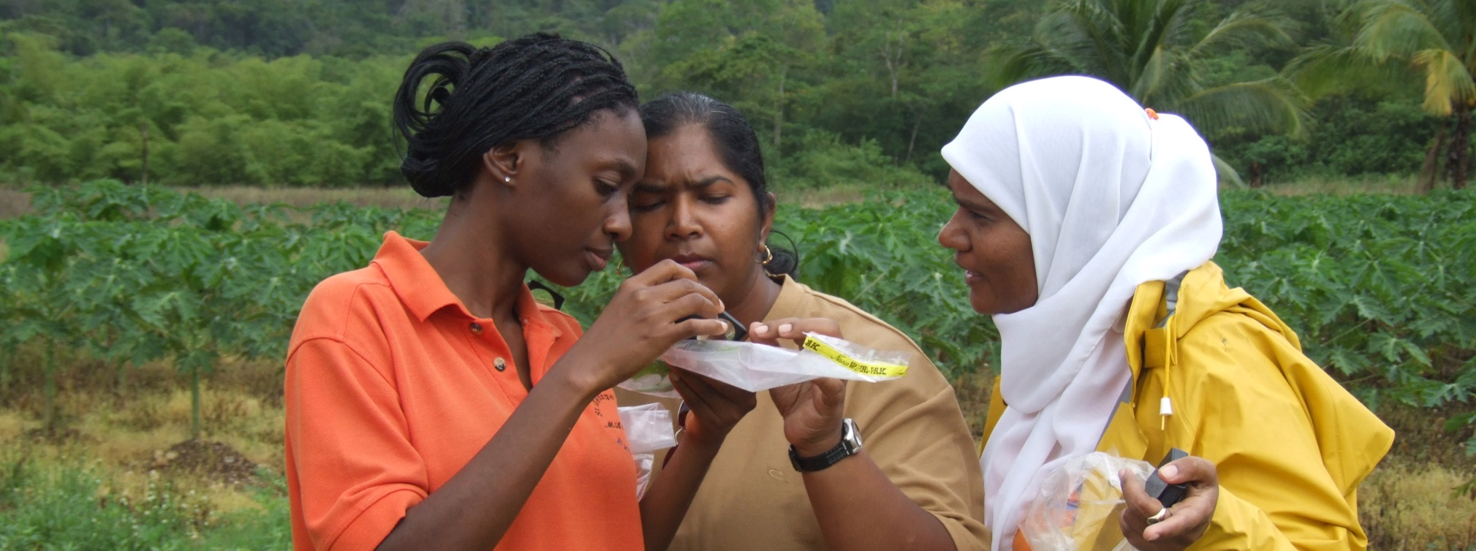
CABI
A unique international organisation
Trevor Nicholls, CEO

Slide 2
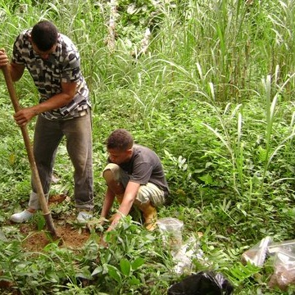
What is CABI?
CABI is a not-for-profit
science-based development and knowledge organization
KNOWLEDGE FOR LIFE

Slide 3
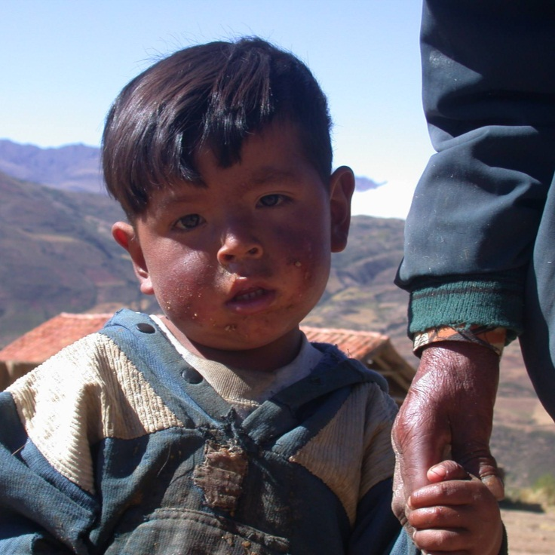
Our mission
CABI improves people’s lives worldwide by providing information and applying scientific expertise to solve problems in agriculture and the environment
KNOWLEDGE FOR LIFE

Slide 4
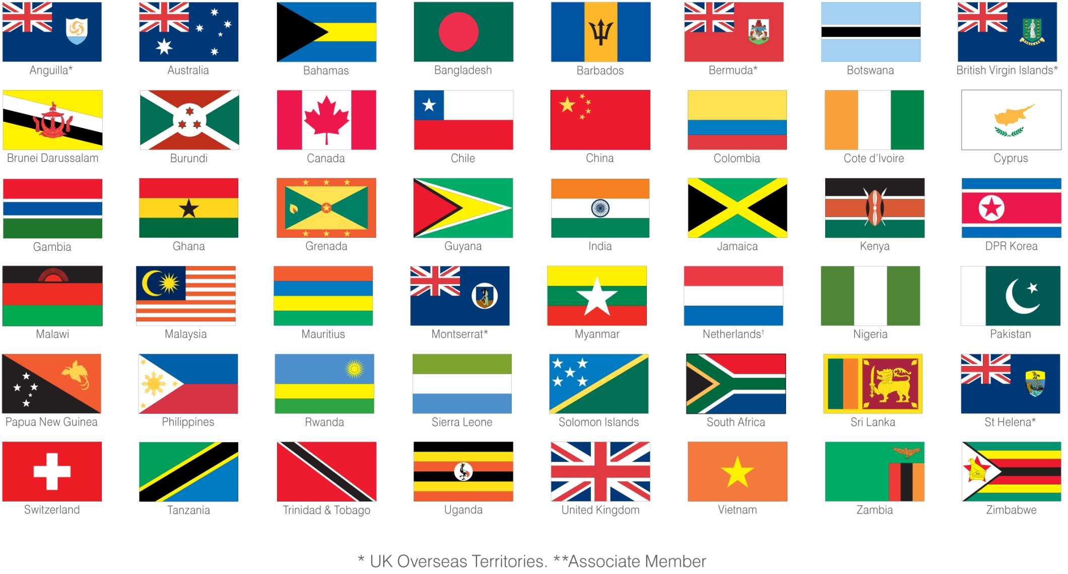
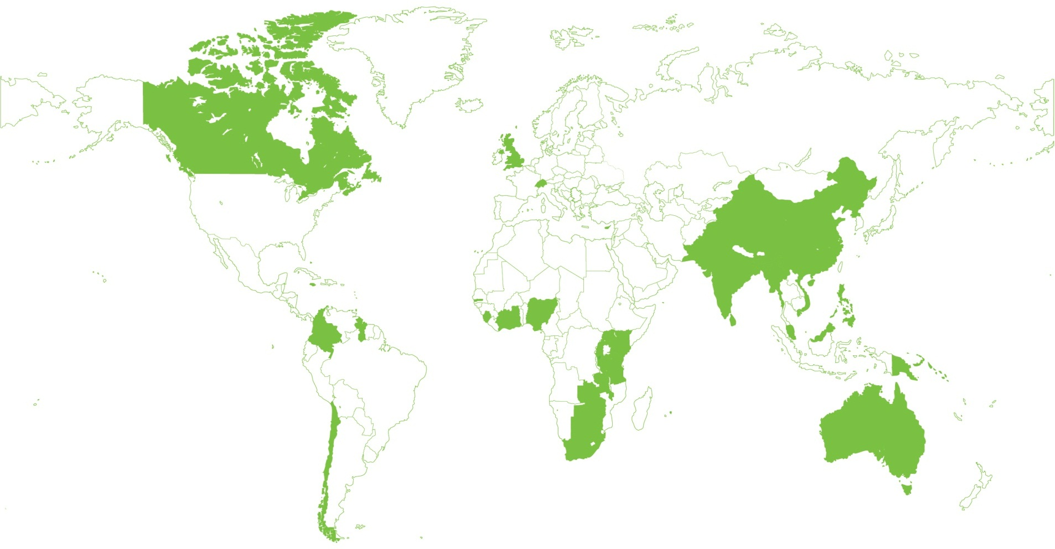
We work on behalf of 48 member countries

Slide 5







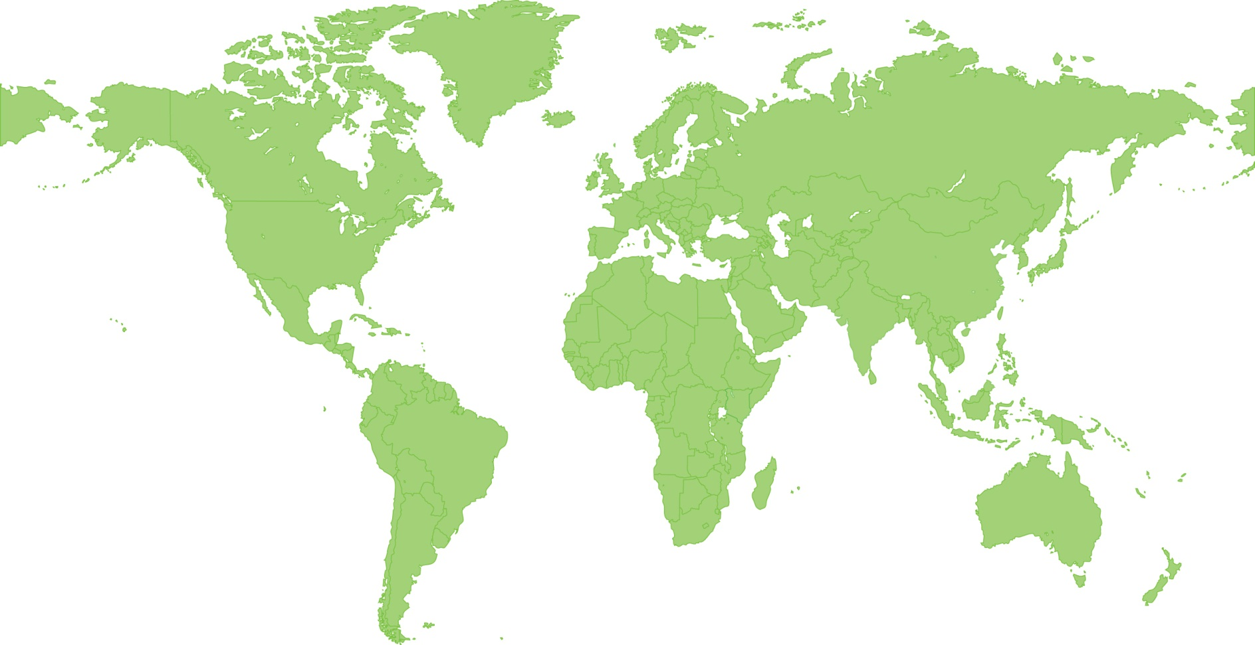







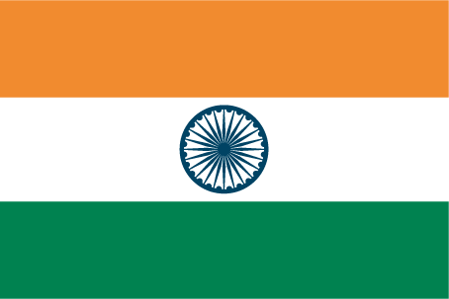





Global reach
We have 400+ staff across 20 locations worldwide
USA 3
UK 195
Netherlands 3
Switzerland 26
Hungary 1
Serbia 1
Bulgaria 1
Trinidad & Tobago 4
China 6
Costa Rica 1
Malaysia 10
Brazil 2
Australia 1
Ghana 3
India 11
Cameroon 1
Uganda 1
Kenya 27
Ethiopia 1
Pakistan 51

Slide 6
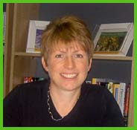
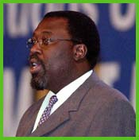

CABI’s business units
  Publishing
    Research databases, books, Compendia
    and Internet Resources
    Agriculture, veterinary science
    human health, leisure & tourism
    Knowledge Management projects
  International Development
    Commodities
    Invasive Species
    Knowledge for Development
    Bioservices
is a “one CABI” initiative drawing skills and resources from both core businesses
Notes:
Many of you will know us for CAB Abstracts or perhaps the Crop Protection Compendium. Shortly we shall also be launching the Invasive Species Compendium. Though both will remain available separately, each is planned to be developed in the context of the Plantwise programme and integrated within it in future years. CABI’s other key area of expertise is in International Development, supplying expertise to numerous projects in developing countries, and capturing insights into crops – commodity and staples – plus pests and diseases.

Slide 7
CABI Revenues 2014
($million)
100% = $46.5 million

Slide 8
Strategic Goals
Greater food and nutrition security
Increased farmer incomes
More sustainable farming practices
Protection of environment and biodiversity

Slide 9
Competencies, Content and Channels
Print
Electronic
Mobile
Video
Clinics
FFS
Personal
Communicating Science to Build Knowledge & Capability
Human
Health
(Nutrition)
Plant Health
Pests & Disease
Seed
Health
Soil
Health
Animal
Health
Environmental
Health
Defensive
Offensive
crops
invasives
Notes:
main heading – 32bold green – no more than 2 lines
text – 24/20 dark grey.
if you need smaller than a 20 THERE IS TOO MUCH ON YOUR SLIDE
The “indent” (increase list level) button creates bullets
please do not use the “bullet button”
bullets should not end in punctuation e.g. : or . or ; or …
bullets can end in ! or ?
green may be used to emphasise words
TO ADD MORE SLIDES in Office2007 use the ‘New Slide’ dropdown on the ‘Home’ ribbon

Slide 10
Communicating with farmers – greater reach, frequency and impact
Individual
farm visits
Farmer
field schools
Mass
media
Impact
Reach

Slide 11
Communicating with farmers ….. complementary channels for impact
Individual
farm visits
Farmer
field schools
Plant clinics
Mobile
Internet &
Social Media
TV, Radio
Videos
Impact
Reach

Slide 12

CABI in 2020 – healthy, sustainable agriculture
Digitally powered
Weeds & Invasives
Nutrition
Soils
Trade and market access
Seeds
& plant health
Gender sensitive
Integrated and sustainable
Mobile/ICT
Climate smart

Slide 13
Mapping to needs and objectives
Builds capacity
in:
Supports strategic goals:
Theme/Initiative
Publishing/ Knowledge Management
Availability, communication and use of knowledge
More sustainable farming practices
Mobile
Bioservices
Protecting biodiversity and environment
Protection of environment and biodiversity
Invasive species
Climate smart agriculture
Knowledge for Development
Greater food and nutrition security
Better systems for plant health
Plantwise
Commodities
Improving trade and market access
Increased farmer
incomes
Trade and Markets

Slide 14
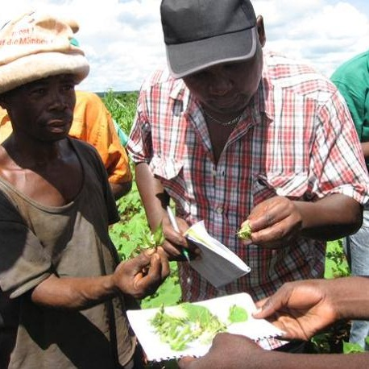
Integrated Crop Management
Improving cotton production
Using integrated crop management approach including gender-responsive options
Targets:
  Cut pesticide use by 50%
  Increase incomes by >30%
  Establish >200 farmer field schools
To date:
  113 field school trainers trained
  104 field schools reaching >2000 farmers
Mozambique and Kenya
2010 – 2013
Funded by CFC, European Union & participating Country governments
Notes:
14
Reference notes about this project:
Cotton yields aren’t what they could be in Mozambique for a number of reasons including: low quality seeds, poor land preparation and inadequate pest control.
Project activities:
The project team is working with all those involved in the cotton value chain – from farmers and their associations to ginneries, input providers and regulators to analyze the production system to identify key issues and constraints.
Providing smallholder cotton farmers with a combination of improved knowledge of production practices and practical support activities.
Formulation and promotion of innovative gender-responsive integrated crop management options
Establishment of a training programme for farmers in both countries
Establishment of pilot schemes for delivering inputs and validated technical support. A number of trainers will demonstrate the different techniques of the integrated crop management strategy to farmers on field demonstration plots in the cotton growing regions in each country. >200 farmer field schools will be established. The farmers involved will learn by doing and see the results of the new techniques for themselves. Once they do, it is hoped that they will adopt these techniques on their own land.
Some of the targets:
increase cotton production at the demonstration sites
cut the pesticide use of participating farmers by 50%
increase their incomes by at least 30%.
Results so far:
113 field school trainers trained
104 field schools reaching > 2000 farmers
Baseline studies happened, results shared and published
Through scouting of pests done during AESA, the participating farmers in the FFSs where pest management options were being evaluated reduced the number of sprays from 8-12 to 5-6 during the 2010/11 cropping season.
During the 2010/11 cropping season in Mozambique, the yield of seed cotton from the ICM plots (strip intercropping of cotton with maize/soya beans, with scouting of pests) was as high as 1,682 kg/ha compared to 552 kg/ha in the non-ICM plot (farmers practice)in the same FFS
Dates:
December 2009 – December 2013
Funding:
CFC, European Union & participating Country governments

Slide 15
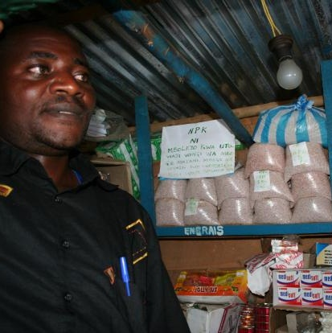
Development
Know-how
Africa Soil Health Consortium
  Acts as the interface between developers of integrated soil fertility management knowledge (e.g. projects) and those who use the knowledge - extension workers, agrodealers and farmers
  Works with partners to design information materials that are customised for the target audiences
  Materials include policy briefs, booklets, radio and TV programmes
Sub-Saharan Africa
2010 – 2014
Funded by the Bill & Melinda Gates Foundation
Notes:
15
Reference notes about this project:
The project supports knowledge sharing on Integrated Soil Fertility Management (ISFM) for increased crop productivity with the goal of improving livelihoods.
Project activities:
The project is developing materials that collate and synthesize knowledge on ISFM in Africa.
The knowledge already exists and comes from researchers, extension workers and farmers.
The project is repurposing this information into appropriate communications materials so that they can be used by development practitioners to improve productivity
The project is also providing access to knowledge held by partner organisations
Getting research from the lab in to the field and into practice.
Creating materials targeting a range of different stakeholders including: extension workers, farmers, agrodealers etc
What’s been achieved so far
Priority cropping systems agreed
Level 1 Handbook and Video are in final stages of being produced
Articles, papers written and submitted
Structure of Level 2 Pocket Guides drafted
Draft decision support tools developed and being evaluated
A number of partners visited by ASHC staff and inventory of stakeholders and projects developed
Engagement with partners started and Development of Level 3 Extension materials (leaflets, manuals, etc.) initiated
Gender strategy and Monitoring and Evaluation plan developed and ready for review
Project promotion materials (flyer, newsletters etc.) developed
Project website development initiated
Technical Advisory Group constituted, office bearers elected and commenced operation
Location of project activities:
The Project area is sub-Saharan Africa. The project will engage directly with partners in a few countries and have started interactions in Tanzania and Mali. Ghana and a 4th country to follow.
Besides the 4 countries we’re engaging with others and have so far done so in Zambia, Tanzania, Malawi, Uganda, Kenya and Rwanda.
Funding:
Bill and Melinda Gates Foundation
Duration:
2011 - mid 2014

Slide 16
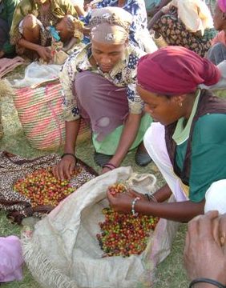
Trade & market access
Funded by:
Perking up coffee in Africa
Farmers in Ethiopia, Rwanda and Cameroun get a better return for their coffee crop after learning new processing techniques that improve the quality of their coffee:
Farmer field schools teach new processing techniques to deliver higher quality
Marketing helps farmers stimulate demand for coffees produced by the new approach, with premiums of over 30% above the usual prices being realised.
Microfinance initiatives help more farmers buy equipment to adopt the new techniques
Funded by:
CFC
World Bank
Rabobank
Notes:
To maximise the impact CABI has on issues in agriculture and the environment we focus our work on three key scientific areas, recognising that these are major issues in today’s world.
Commodities - Working across the commodity chain from producer to manufacturer, to lower production costs and improve profits from higher quality produce through sustainable and biodiverse agricultural practices. Our scientists are specialists in Coffee & Cocoa.
As a reference point, please see page 20. CABI in Review 2005. A story about CABi’s work in Palm Oil
Invasive species management - Managing invasive species threats in agriculture and the environment. As a reference point please see page 19, CABI in Review – Slowing the ‘mile a minute’ weed – Mikania Micrantha
Information for development - Aiding knowledge sharing. Delivering knowledge from research into application within rural or disadvantaged communities. See page 22, CABI in Review ‘Women to Women Seed Health Videos in Bangladesh

Slide 17
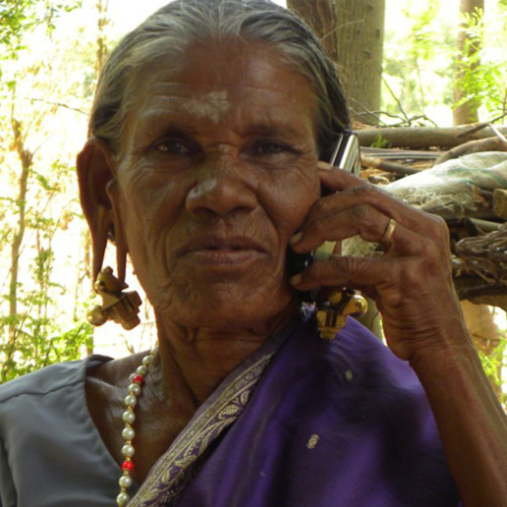
India – Africa partnerships
Mobile Agro-Advisory services
Africa and India
  India – successful pilot project with IKSL (IFFCO/Airtel), won BITC award for excellence in 2011
  India: development of ‘Direct 2 Farm’–database of farmer centred actionable information, testing ‘offshoring’ of several activities
  Africa: leveraging on work in India – working with GSMA projects to develop mobile agro advisory services with Airtel in Kenya; with ESOKO in Ghana.
  Pakistan: successful delivery of ‘New and Emerging Technologies’ grant for mobile agro-advisory services, leading to new DFID grant award 2011 – 2013
Notes:
17

Slide 18
Biological control
Tackling invasive species
  CABI has been working in Europe for over 100 years
  CABI centres in UK and CH
  Unique quarantine facilities
  Working with Governments / national research organizations / educational establishments / non-governmental and community based organizations / the private sector / EC / international agricultural research centres
Notes:
18

Slide 19
CABI’s food security strategy – lose less, feed more

Slide 20
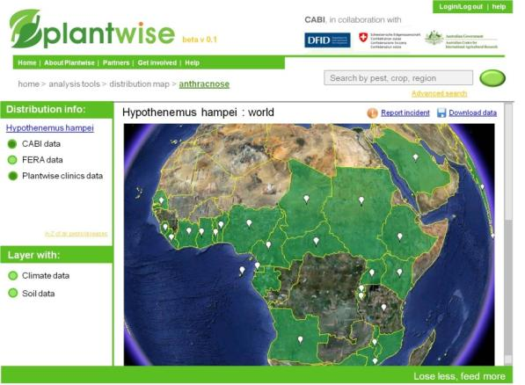
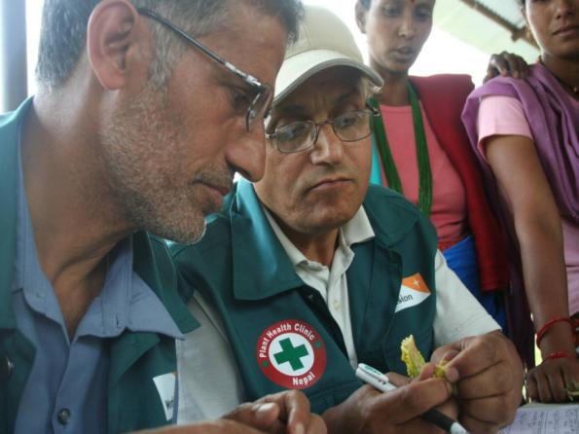
Think global, act local
Content from CABI and partners
Expertise from CABI and partners
  screen shot
Knowledge Bank
Knowledge Bank
Plant Clinics
Plant doctors
Plant Clinics
Data for prevention, identification and management
Public good: trade,
knowledge, food security
Practical assistance for farmers
Global reporting network
Notes:
In positioning CABI as the Global Plant Health Centre, we will extend the the current pilot project on Plant Clinics to train plant doctors and establish a network of plant health clinics in at least 25 countries around the globe.
These plant health clinics will provide immediate benefits to local farmers but will also contribute surveillance and monitoring of plant pests and diseases to a comprehensive global database which will also contain content from CABI and other partners.
Initial focus on Pest and Disease information but long term intention will be to cover all aspects of plant health. The database will have a significant part of its content which will be available on an open access basis, forming a public good which will help build knowledge in support of food security and trade. We also envisage that certainly value-added analytical tools, reports and consultancy services will be paid for so as to ensure that the concept is financially self-sustaining.

Slide 21
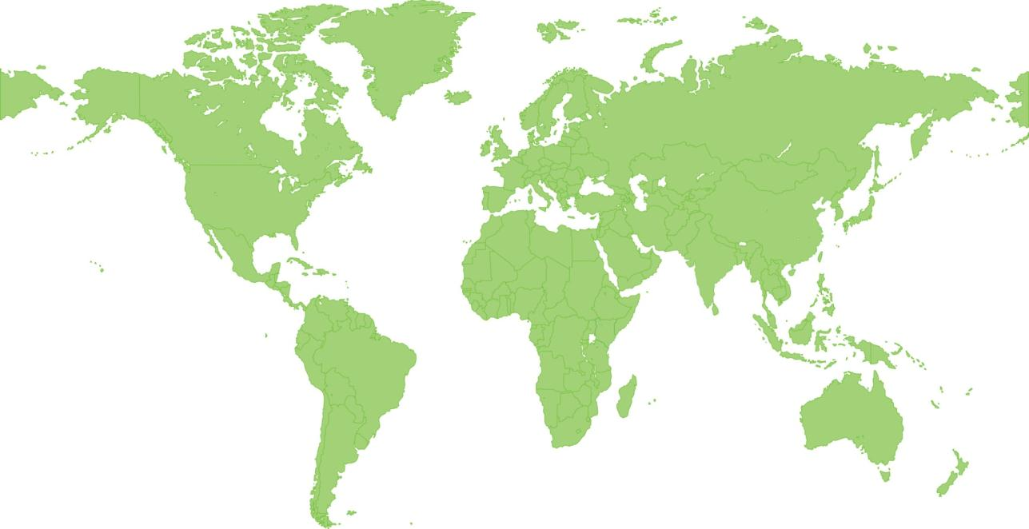
PW Implementation 2013
  Caribbean & Central America
  Nicaragua
  Suriname
  Honduras
  Barbados
  Grenada
  Trinidad & Tobago
  East Asia
  China
  SE Asia
  Cambodia
  Vietnam
  Africa
  DR Congo
  Kenya
  Rwanda
  Sierra Leone
  Uganda
  Tanzania
  Ghana
  Zambia
  C&W Asia
  Pakistan
  Afghanistan
  South Asia
  Bangladesh
  India
  Nepal
  Sri Lanka
  Latin America
  Bolivia
  Peru
  Brazil
Notes:
The ‘Proposed Organisation Structure’ slide states the CABI staff members who are proposed to fulfil the roles identified as required for the project (depending on the project level) – note that the availability of these staff members for this project should already be confirmed.
Corporate Management (and authorisation of a project) will be dependent on project level, as given below for Donor-funded or Investment projects respectively:
Donor-funded Projects:
Level 1 (Gross Income > £250k) = PMG
Level 2 (Gross Income £50k-£250k) = Global Director, Publishing Business Innovation Forum (PBIF), or EMT Member
Level 3 (Gross Income < £50k) = Regional Director, Publishing Senior Manager, or EMT Member
Any Level with NPC < 15% = PMG
Investment Projects:
Level 1 (Total Implementation Costs > £250k) = PMG
Level 2 (Total Implementation Costs £50k-£250k) = EMT Member
Level 3 (Total Implementation Costs < £50k) = Regional Director, Publishing Senior Manager, or EMT Member
Any Level with any of the following = PMG
Total CAPEX > £50k
Internal Rate of Return (IRR) < 10%
Payback > Year 4
Project Board
The roles should be filled by CABI staff with external perspectives being represented by a CABI staff member. Where Project Board meetings occur, these should be internal to CABI, with ‘special’ Project Board meetings being held with external parties as required. Projects of level 3 may not have a Project Board, however there should always be a Project Executive.

Slide 22
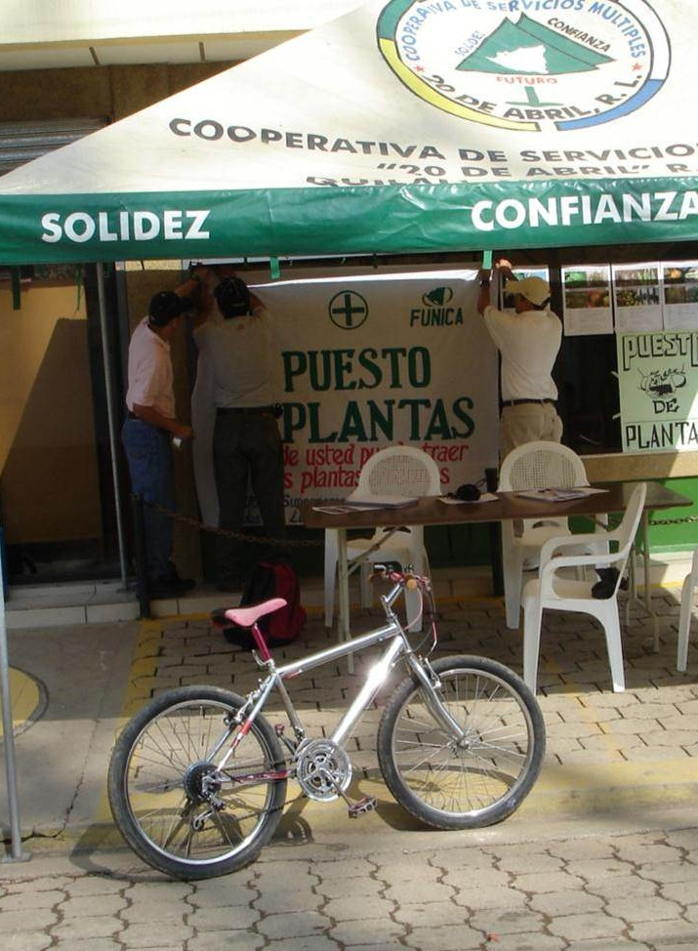
How the clinics work
  Set up at local meeting places
  Free at the point of use
  Farmers come with problems and samples
  Receive a diagnosis and a ‘prescription’ from the plant doctor
Notes:
Clinic in DRC

Slide 23
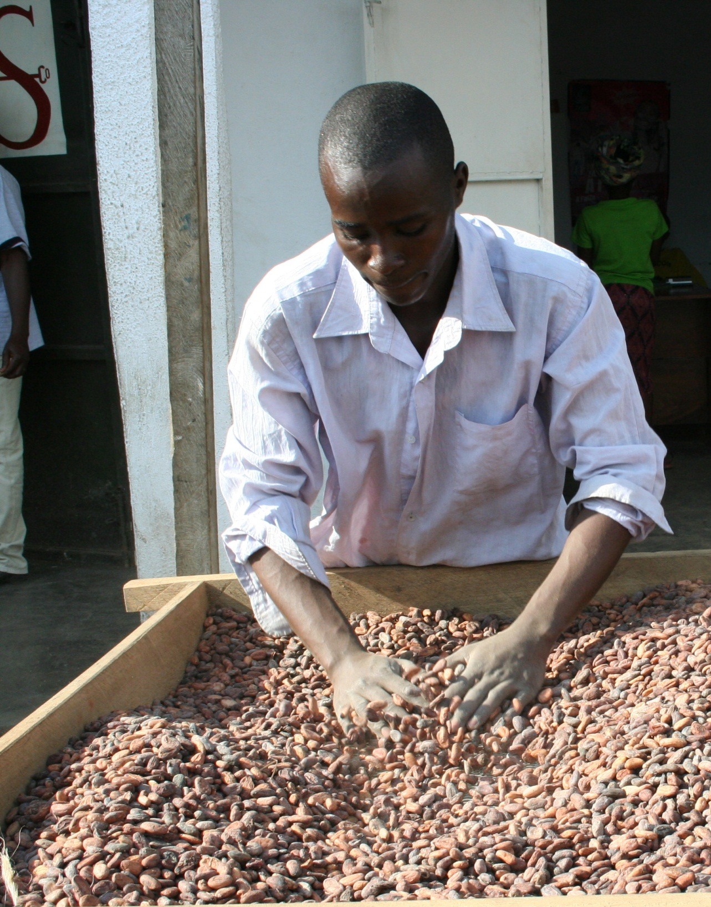
Private Sector: ESCO
  North Kivu, DRC; exports cacao, coffee, vanilla, papain and cinchona
  6000+ registered farmers
  Clinics support farmers and help to improve production
  Clinics based at depots where farmers deliver produce
  Identify problems and effective responses
Notes:
Esco Kivu is a company with a long history in Eastern Congo, since its establishment in the Democratic Republic of Congo in 1970.
ESCO currently exports cacao, vanilla, papain, and cinchona produced by smallholder farmers.
ESCO started introducing cocoa growing in North Kivu and Province Orientale in 2000, and now seeks to establish 12,000 certified organic farmers in North Kivu and Province Orientale. ESCO activities in promoting cocoa production and providing market opportunities have been very successful and few alternative income generating activities exist. However, as a result farmers develop fields rapidly without adequate knowledge of appropriate techniques. This leads to production problems and increasing risk of disease occurrence.
Clinics are established at depots where cacao produced by smallholder farmers are collected. The clinics support farmers to learn the right practices early on and be able to avoid or combat disease problems effectively. This will contribute significantly to increased yields giving ESCO better economies of scale.

Slide 24
Clinics have broad reach….
Bolivia (Feb 00 – April 09)
  Average of 11.5 queries per clinic session
9195
Queries
6815
Users
801
Sessions
10
Clinics

Slide 25
Impact Bangladesh clinics
350 farmers interviewed | Average
Farmers spent less money (mostly by using fewer agrochemicals) | $16.71 saving
Yields increased | Over 9% increase
Farmers’ gross income increased | $325 increase per harvest
Livelihoods improved 95% of the farmers earned extra income by adopting the plant clinic recommendations | Farmers spent the additional money on: Children's education (25%) Home improvement (21%) Investment in the farm (43%) Buying a cow (13%) Planting (9%) Buying land (9%) Growing a crop (7%) Agriculture (5%) Other (11%)

Slide 26
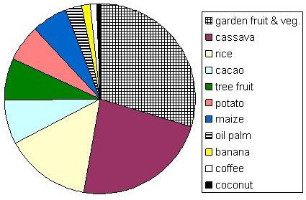
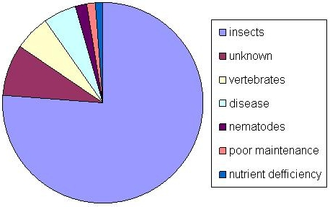
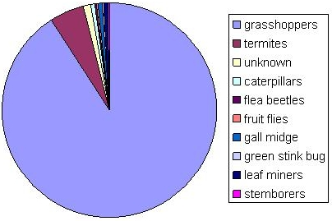
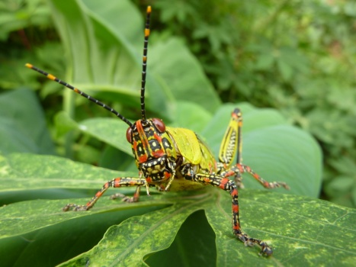
Clinic data at work
Pest analysis:
cassava
Data set:
1500 queries
Notes:
The plant clinic data can be used to identify emerging crop pests or crop problems that farmers are most concerned about. This can be useful in addressing the needs of the farmers and in planning extension campaigns or other activities. It may also identify pest groups that plant doctors are less familiar with or indicate which crops have problems that are difficult to diagnose.

Slide 27
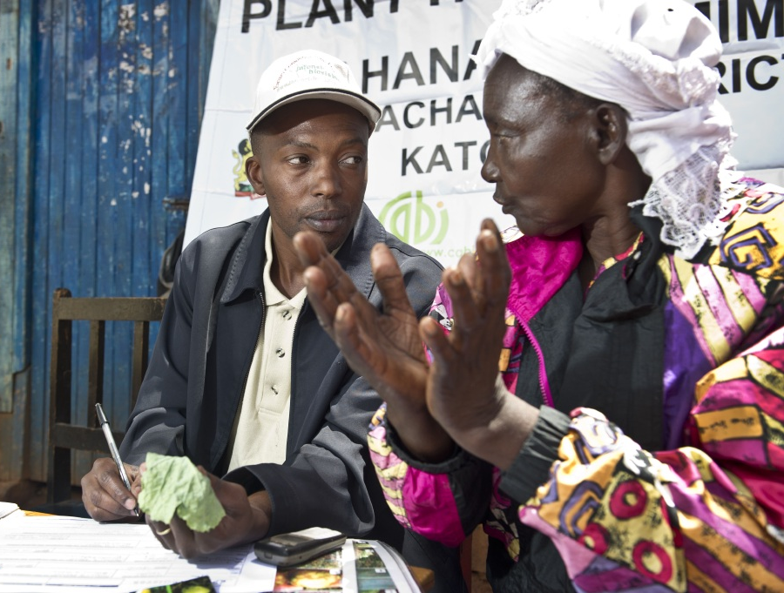
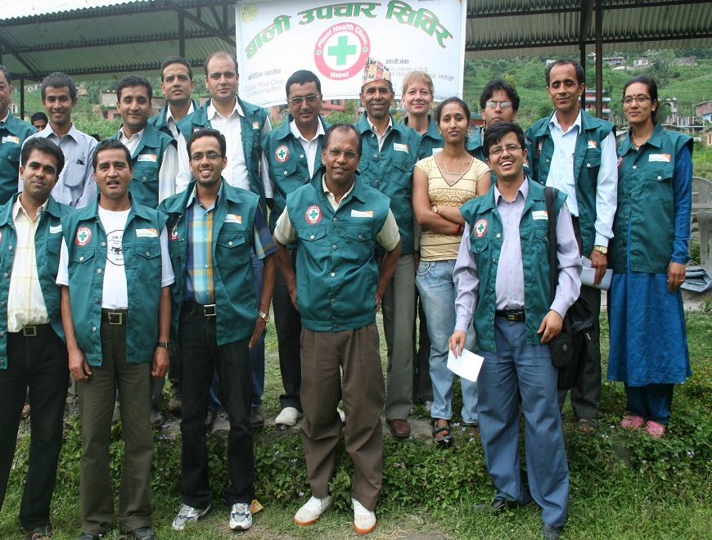
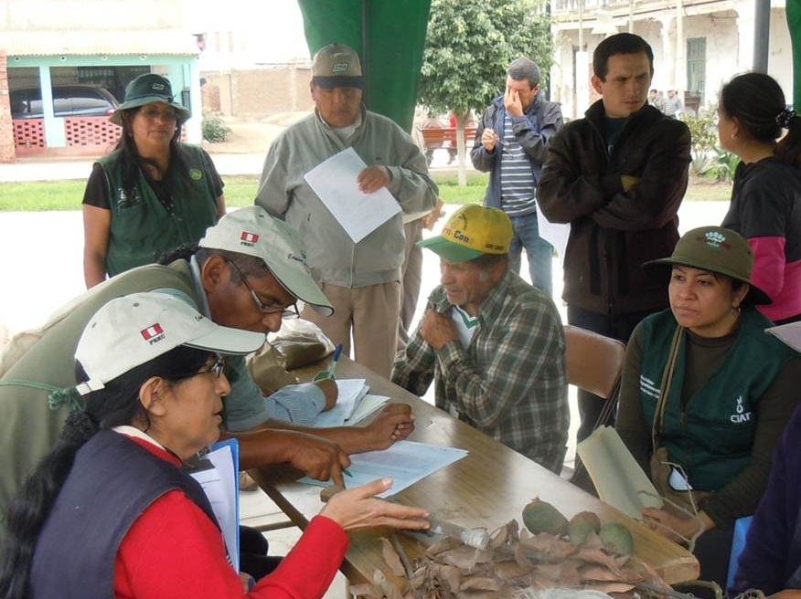
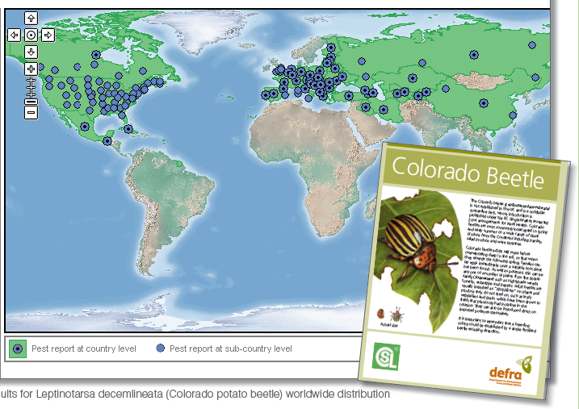
  >700 clinics in 31 countries
  Over 2000 plant doctors trained
  Estimated >600,000 farmers helped
  Open Access Knowledge Bank
Notes:
With the help of over 70 local and international partners…
182 clinics in 16 countries
Over 1000 plant doctors trained
Already helped, estimated, 100,000 smallholder farmers
Fully working prototype of a knowledge bank

Slide 28
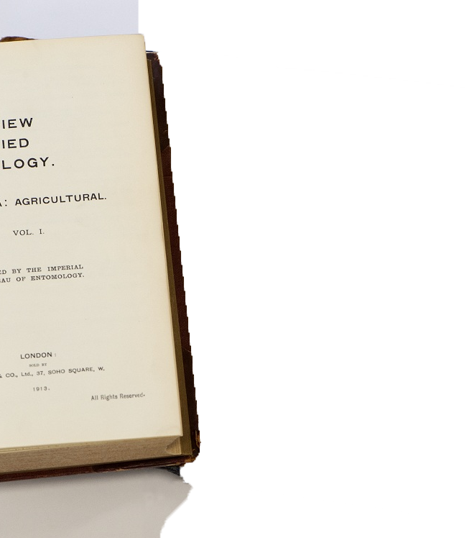
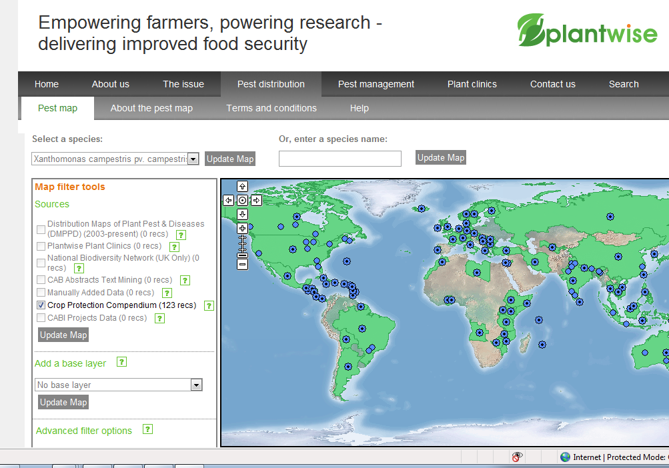
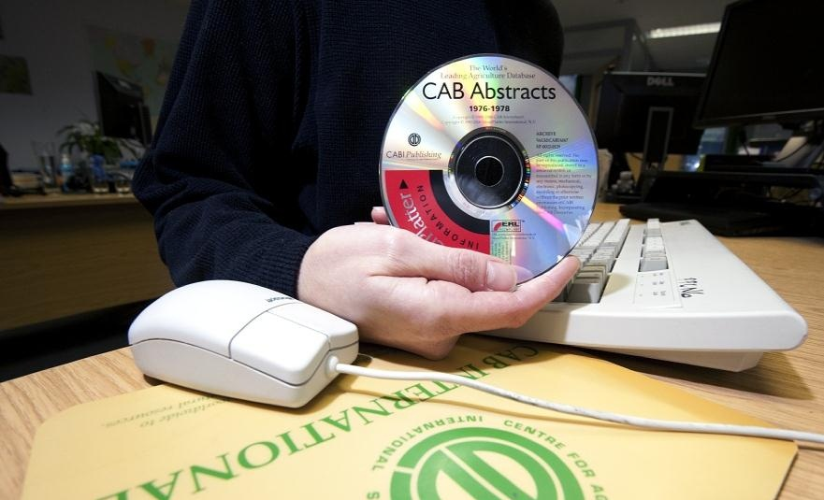
Open Access Knowledge Bank
  100 crops, 2,500 pests/diseases
  7,500 factsheets
  Creation of links to numerous online information resources
  Positive user feedback
  Over 250,000 page visits per year from 188 countries
  18,000 plant clinic records
  Online management tools for collecting and quality controlling clinic data

Slide 29
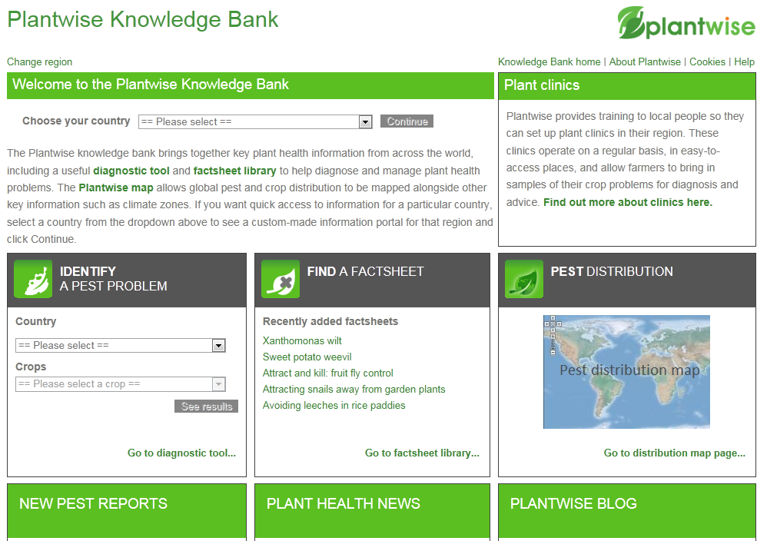
Knowledge Bank

Slide 30
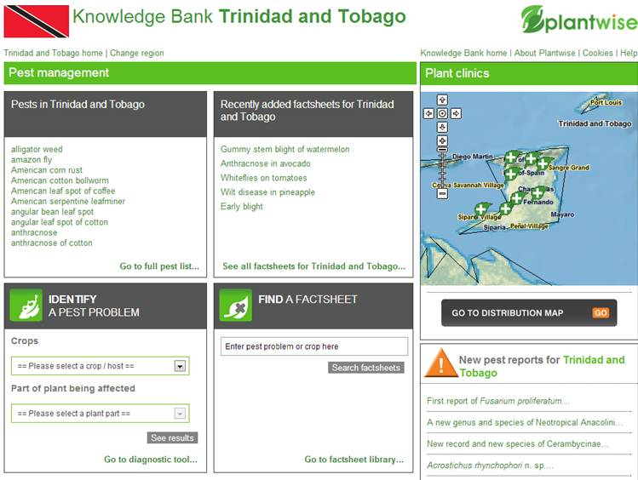
Country tailored homepages
Notes:
This is the type of country-specific page we will be developing, in this case using Trinidad as an example. This will get focused information on 1. identification, 2. treatment and 3. distribution of relevant pests to plant doctors and government agencies helping them find rapid solutions to their problems.

Slide 31
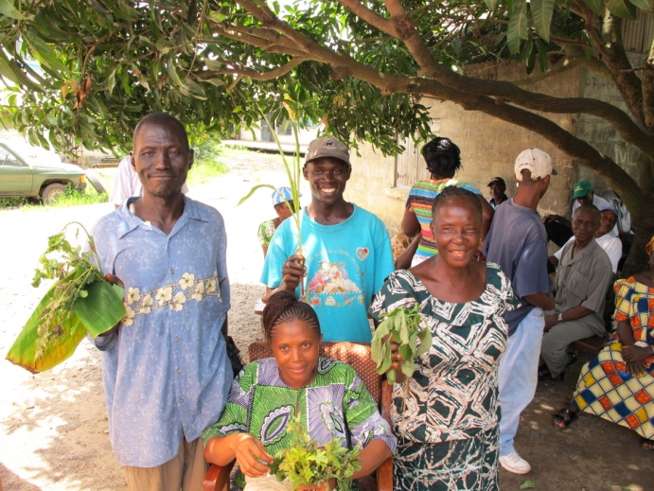
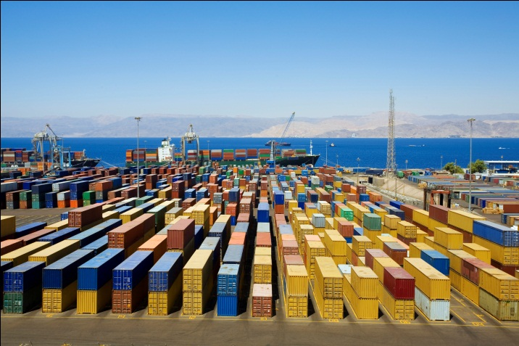
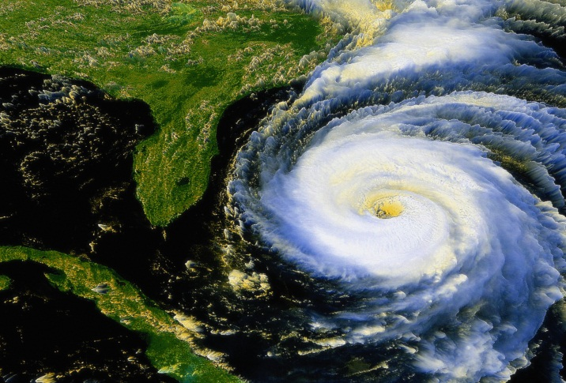
Comprehensive resource
  Fact sheets and practical help
  Diagnostic guidelines
  Treatment and mitigation advice
  Pest risk assessments
  Clinic data
  Quarantine information
  Legislation and safety information
  Mapping and analysis tools
  Supporting literature

Slide 32
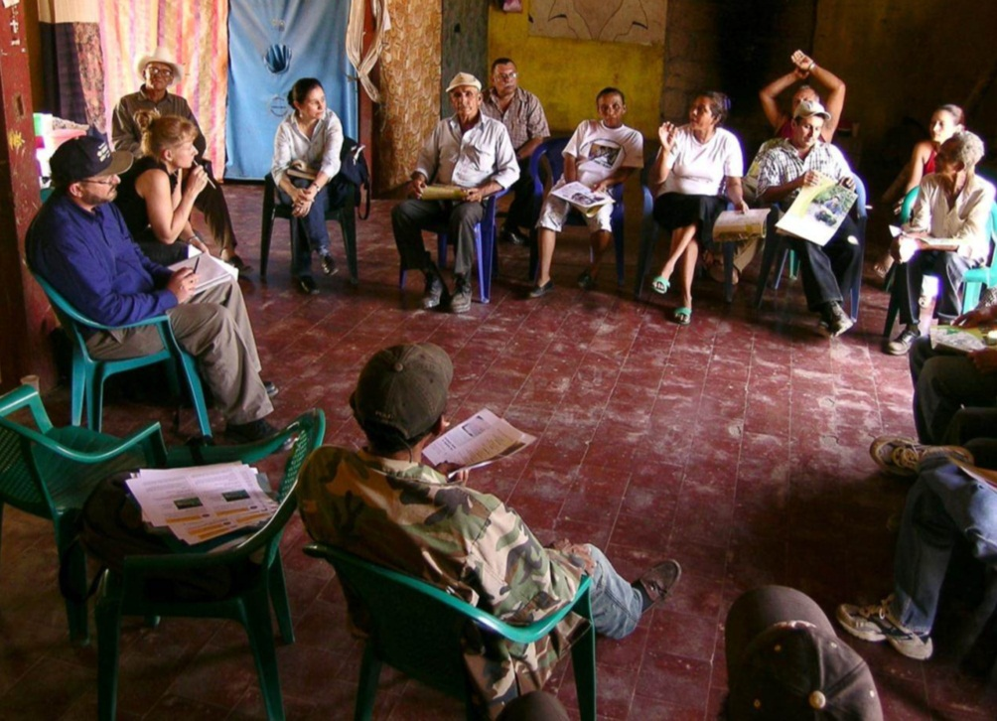
Value to many users
  Practical advice for farmers and extension services
  Open access to data and information for scientists
  Analytical tools and support for trade and policy
Researchers
Policy makers
Extension workers
Agrochemical suppliers
Plant protection services
Food producers
and traders

Slide 33
What differentiates CABI from others?
  CABI focus - Lose less, Feed more,
  CABI puts research into use
  CABI’s governance marries interests of developed and less developed parts of the world
  Developed Member Countries use CABI’s expertise (e.g. UK, Switzerland, Canada) and contribute to the CABI Development Fund
  CABI’s less developed Member Countries rely on CABI to source programmatic support from donors

Slide 34
ke itumetse
teşekkür ederim
grazie
kiitos
terima kasih
xie-xie
terima kasih
dank u
merci
спасибо
faleminderit
efharistó
cảm ơn cô
谢谢
salamat
நன்றி
dhanyawaad
asante sana
शुक्रिया
urakoze
mersi
danke
zikomo
ありがとう
Assalamualikum
stuh-tee
благодаря
thank you
obrigado
tak
gracias
Trevor Nicholls
CEO
E: t.nicholls@cabi.org

