Slide 1
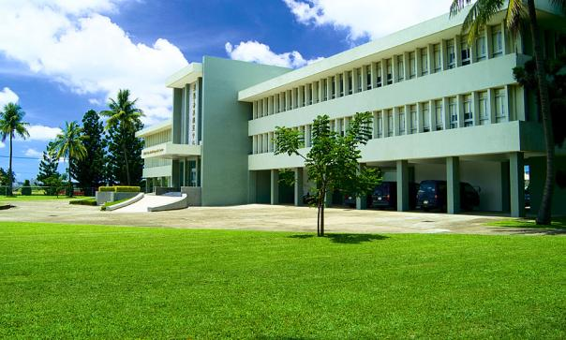
UN Sustainable Development Goal 2: End hunger, achieve food security and improved nutrition, and promote sustainable agriculture
Abolish hunger and malnutrition
Shifting towards healthier diets;
Ensuring the supply of safe, nutritious food: Double production and profits
Preserving biodiversity and the environment;
Reducing food losses and waste;
New visions and business models for smallholders;
Empowering women along the value chain; and
Coherent policies at all levels.
AVRDC – The World Vegetable Center
HQ ADMINISTRATION BUILDING
Notes:
Led by Achim Dobermann (IRRI), team including previous Board member Molly Jahn

Slide 2
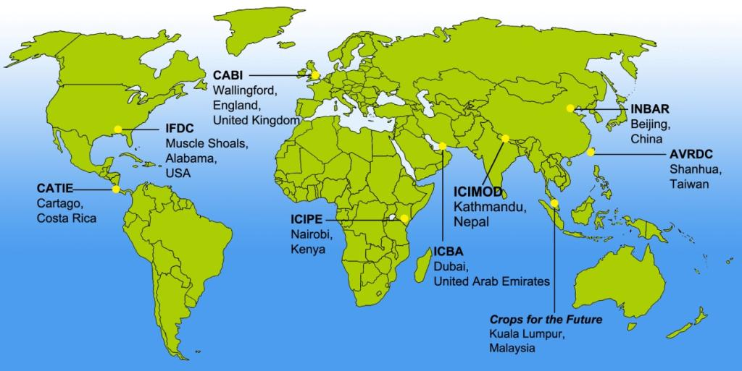
Association of International Research and
Development Centers for Agriculture (AIRCA)

Slide 3
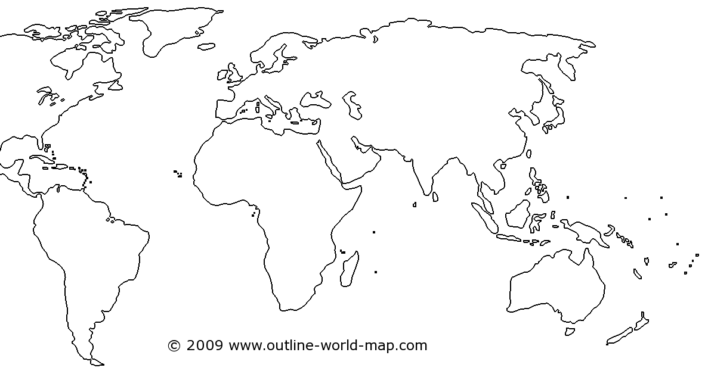
Global expertise, local impact
Central & West Asia and North Africa
South Asia
Headquarters
West and Central Africa
Central America
Eastern and Southern Africa
East & Southeast Asia
Oceania
Notes:
Southeast Asia in 1992
Africa in 1992
South Asia in 2006
Central & West Asia and North Africa in 2010
Split Africa in 2014
In 2008 > AVRDC – The World Vegetable Center

Slide 4
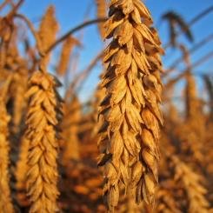
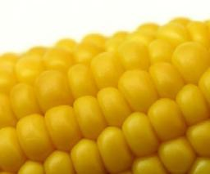
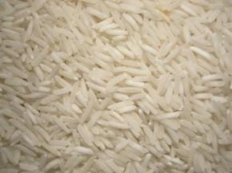
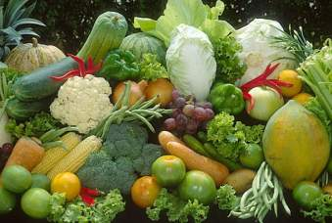
The world food supply is precariously reliant on a very small number of carbohydrate-rich crops and the growing epidemic of malnutrition and non-communicable diseases worldwide is bringing overwhelming health costs
Is Feeding the World without Nourishing it at the same time sensible?
Food and Nutrition Security is the key to overcoming malnutrition!
Much higher rate of return to research in development opportunity crops and smallstock! Why not invest more in vegetables, fruits, fish, livestock and other agricultural products which can help to abolish malnutrition.
Wheat, maize and rice supply more than 60% of humanity’s calories
Thus: We need to move beyond old
Green Revolution thinking in both budget allocation and in Education!
… while other highly nutritious crops are underutilised

Slide 5

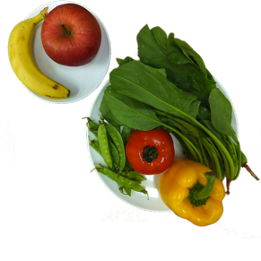

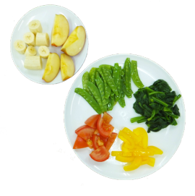
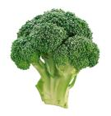

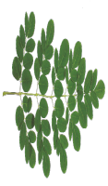

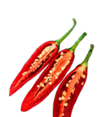

FRUIT & VEGETABLES
more nutritious diets
healthier children and adults
more resilient individuals
and households
200 g of each, daily =
AVRDC – The World Vegetable Center promotes vegetable consumption through
Home and school gardens
Recipes
Food processing training
HOW MUCH IS
400 GRAMS?
RAW
Nutrients in vegetables
Improve children’s ability to grow and learn
Improve adults’ capacity to work and earn
daily fruit & veg consumption = 400 g
COOKED
standard weight of football = 396 g

Slide 6
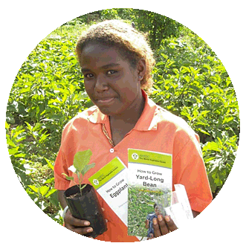
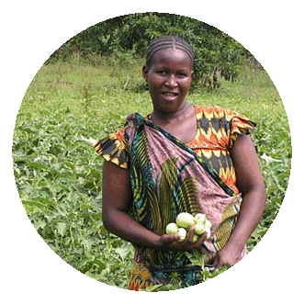
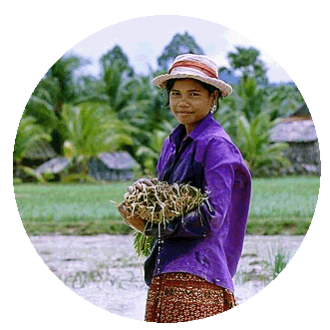
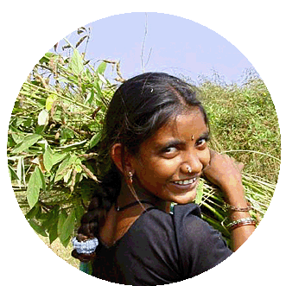
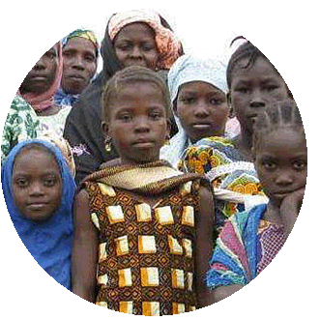
Why AVRDC Says Vegetables are Vital in dealing with emerging challenges and…
1000 days program?
in promoting
good health amongst
poor, young, malnourished women and children

Slide 7
Recommended nutrient intakes (RNI) and % RNI contributed from 100 gram of plant food
 | Protein |  | Vitamin A | Iron | Folate | Zinc | Calcium | Vitamin E
RNI for pregnant women (1st trimester) | g |  | μg RE | mg | μg | mg | mg | mg α-TE
 | 60 |  | 800 | 30 | 600 | 11 | 1000 | 7.5
Percentage of RNI - - - - - - - - - - - - - - - - - - - - - % - - - - - - - - - - - - - - - - - - - - - - - - - - - - -
Rice | 0 | 0 |  | 1 | 2 | 4 | 0 | 0
Cassava (root) | 2 | 0 |  | 1 | 5 | 3 | 2 | 0
Millet | 6 | 0 |  | 2 | 14 | 8 | 0 | 0
Meat (chicken) | 37 | 0 |  | 3 | 1 | 14 | 1 | 3
Mungbean | 40 | 2 |  | 22 | 104 | 24 | 13 | 7
Vegetable soybean | 18 | 2 |  | 13 | 28 | 13 | 4 | 78
Cabbage | 3 | 1 |  | 1 | 10 | 2 | 4 | 2
Tomato | 2 | 18 |  | 1 | 3 | 2 | 1 | 7
Slippery cabbage | 6 | 106 |  | 5 | 30-177 | 11 | 18 | 58
Moringa leaves | 7 | 146 |  | 11 | 49 | 5 | 10 | 65
Amaranth | 9 | 160 |  | 6 | 31 | 6 | 32 | 17
Jute mallow | 10 | 198 |  | 12 | 21 | 0 | 36 | 36
Nightshade | 8 | 101 |  | 13 | 10 | 9 | 21 | 28
Vegetable cowpea leaves` | 8 | 193 |  | 6 | 27 | 3 | 54 | 101
RNI source: FAO/WHO 2004; RNI for iron with low bioavailability; RNI for zinc with medium bioavailability
Nutrient data source: USDA nutrient database, AVRDC IV nutrient data, and literature

Slide 8
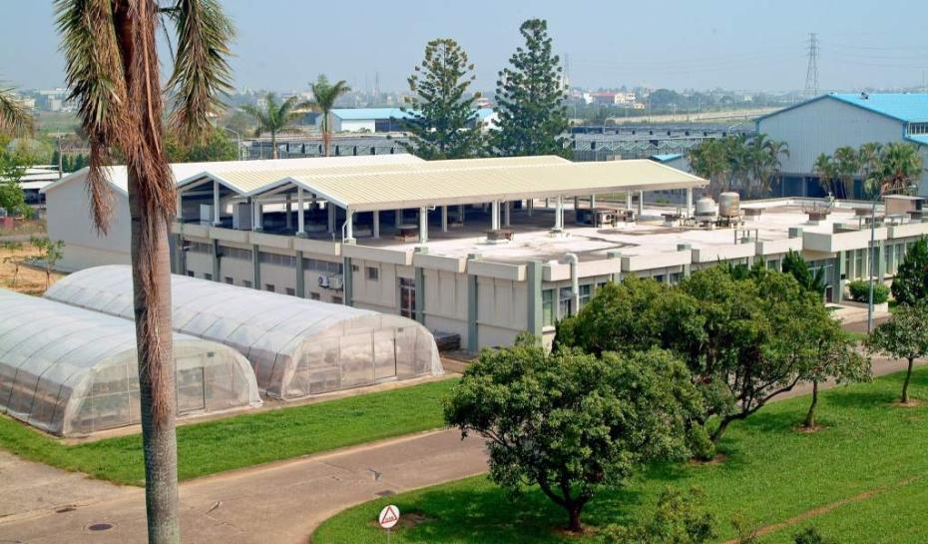
The world’s largest public sector collection of tropical vegetable germplasm
No. of accessions 62,000+
No. of species 436
No. of countries of origin 156

Slide 9
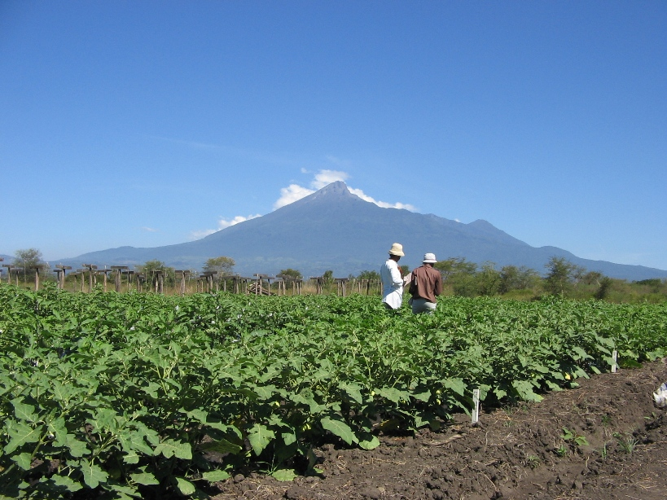
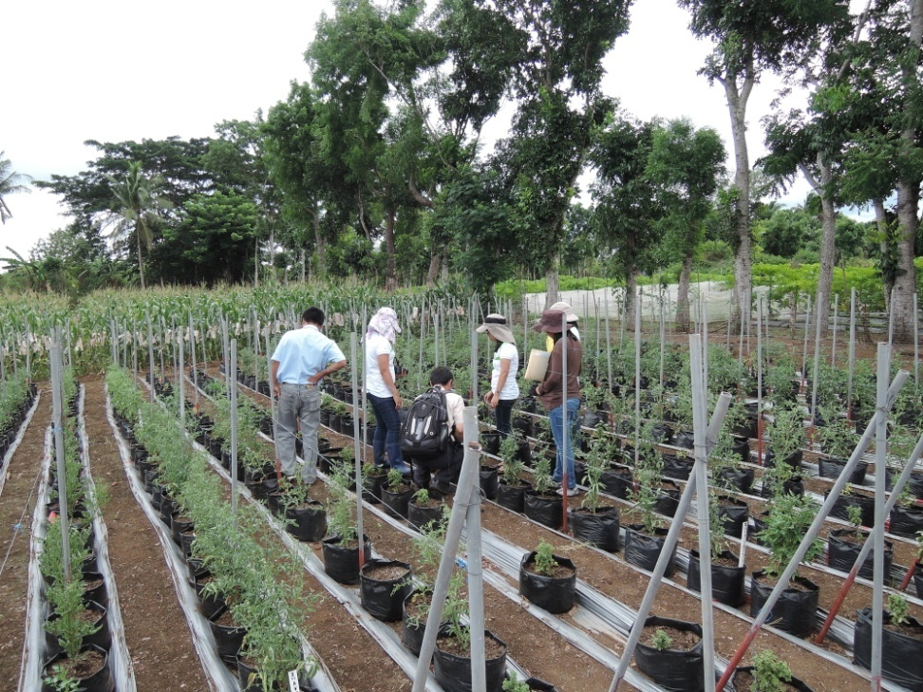
Rijk Zwaan Afrisem Tanzania
75% of all seed companies in Asia sell varieties which include some germplasm originating from AVRDC.
The % is much higher still in Africa
Mt. Kilimanjaro, Tanzania
Working with Enza Zaden and EW Seeds
on virus control in Philippines, India and
other countries in Asia
AVRDC interacting globally with APSA and AFSTA
Notes:
9

Slide 10
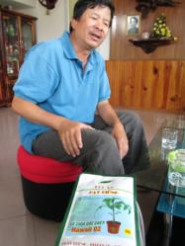
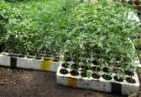
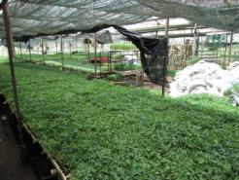
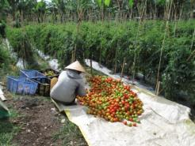
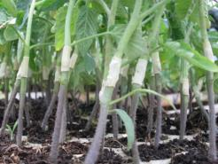
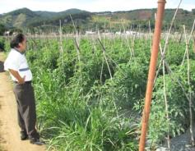
Economic impact of tomato grafting in Lam Dong province, Vietnam
Parameter | Lam Dong province
Yield (t/ha) ª | 73.3
Adoption rate | 100%
Total profit (in million VND/ha) ^{b} | 30.0
Total area under tomato production (ha, 2011) ^{c} | 6,388.0
Total contribution of grafting (in million VND) | 191,640.0
Forex August 2012 average (VND/US$) | 20,703.4
Total contribution of grafting (million US$) | 9.3

Slide 11
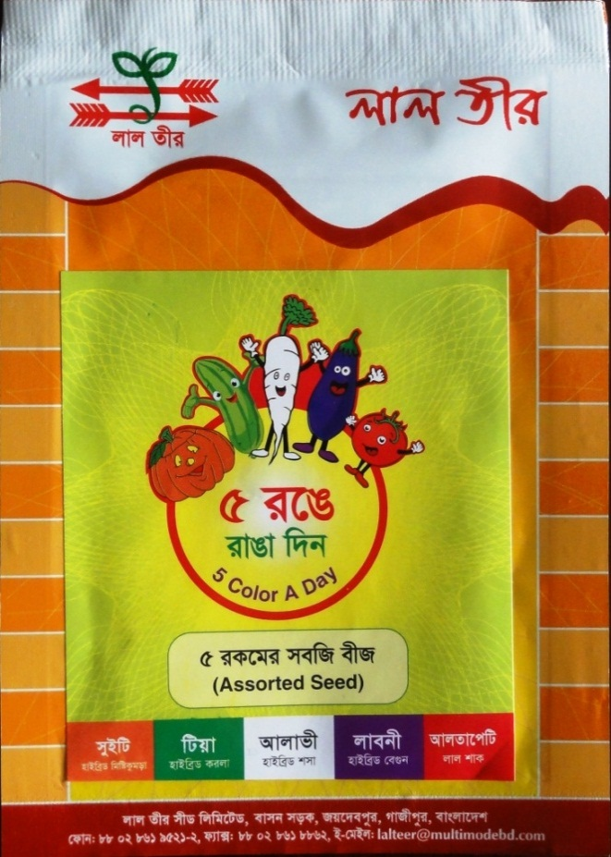
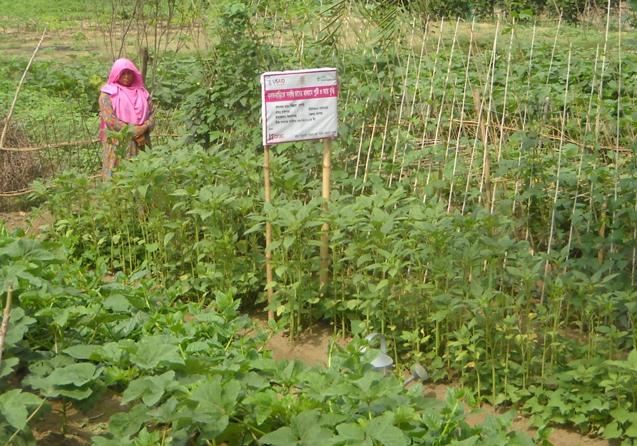
Scaling and private seed companies
Lal Teer Home garden seed packs are living advertisements
Reduced TV advertising
Aimed to sell 200,000
Actually sold over 1 million

Slide 12
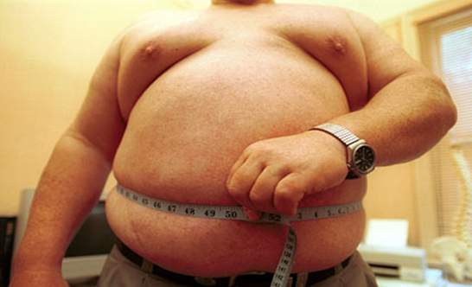
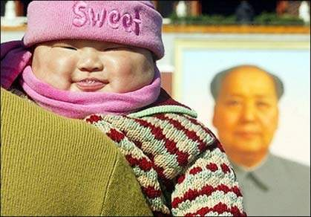
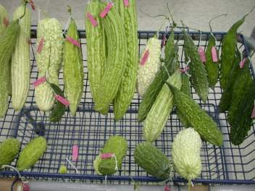
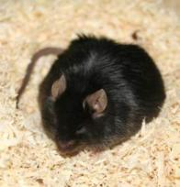
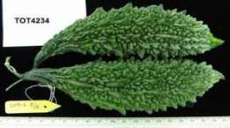
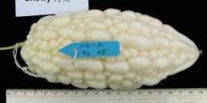
The growing cost of obesity in Asia-Pacific
This is a major problem in Asia and Oceania
Overweight and poor diets are becoming a greater burden for the poor than for the rich with spiraling health costs
The economic costs are 4–8 percent of the economy
Popkin, B.(2008) Health Affairs, 27: 1064-1076
Diets including bitter Gourd may provide effective prophylaxis

Slide 13
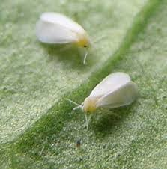
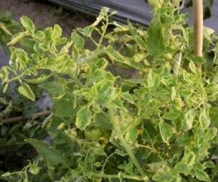
Variation in average annual air temperature (ºC) at AVRDC, Shanhua, Taiwan 1975-2013
Better resilience by reducing overall risks
Prepare for Global Warming Now!
2025 is only one breeding, production and distribution cycle away
See Keatinge et al.
2013 and 2014
Insect & plant disease effects are coming!
4.4 ºC increase
Per 100 years

