Slide 1
Transforming rural livelihoods and landscapes: sustainable improvements to incomes, food security and the environment
Trevor Nicholls, CEO CABI
Global Landscapes Forum
Paris, December 5th 2015

Slide 2

Context
Increasing demand for 4Fs to satisfy ∼9 billion people
Balancing the imperative to increase yields/outputs whilst securing the sustainability of the production environment
Only sustainable through an innovative systems approach to agricultural development
Address the challenge of improving global food security by disseminating science-based development solutions

Slide 3
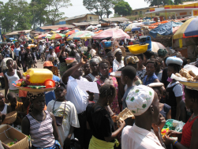

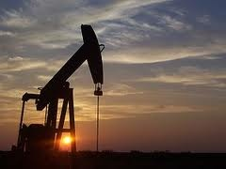
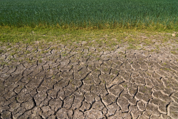
The perfect storm……
Growing world population
Climate change
Dwindling mineral resources
Water shortage

Slide 4
By 2050….
There will be over 9 billion people on the planet
We will need to produce 60% more food
Over 60% of the population will be living in cities
Nearly 40% of the population will be under 18
But….
40% of the population will still be working in agriculture
Smallholders and family farms will produce over 70% of world food
Over 1 billion people will still be at risk of malnutrition and hunger
“Increasing smallholder farmers’ productivity and access to markets can have a profound impact on the livelihoods and general prosperity of literally millions of the world’s poor” – World Bank

Slide 5
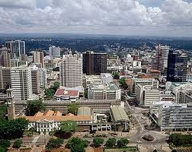
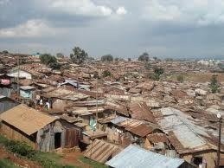
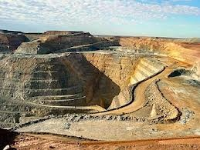
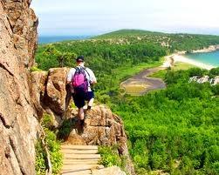
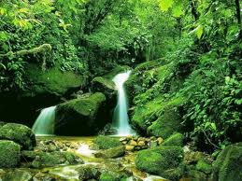
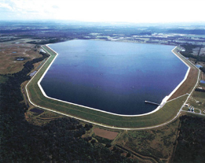
Greater competition for land use

Slide 6
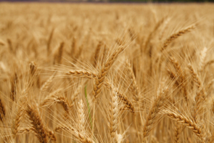
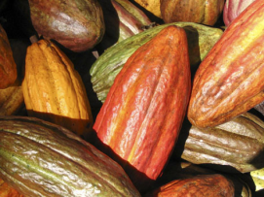
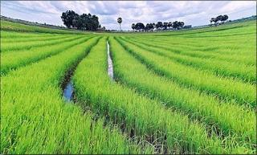
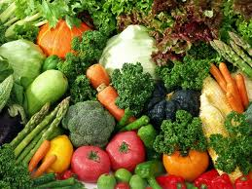
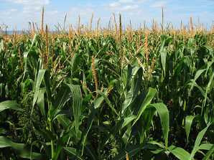
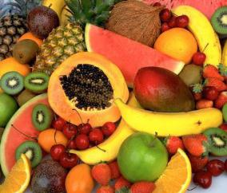
Man cannot live by cereals alone

Slide 7
Landscape challenges
Multiple & complex interactions (soil, water, crops, animals, humans, biodiversity, ecology)
Agriculture vs Ecosystem services
Farm vs Non-Farm Occupations
Cross-Border issues
Government priorities and cooperation
Need to make trade-offs and capture synergies
Lack of good metrics

Slide 8
Sustainable improvements to incomes, food security and the environment
Increase smallholder productivity
Scale-out integrated management approaches
Build greater capacity for climate change resilience and adaptation
Provide good governance and policy support
Improve infrastructure and access

Slide 9
Increasing Productivity
Close yield gaps and increase climate resilience through:
Better soil fertility management
More effective water utilisation
Preventing and adapting to salinisation
Improved access to better varieties and seeds
Promoting greater crop diversity
Losing less to pests, diseases and invasive weeds

Slide 10
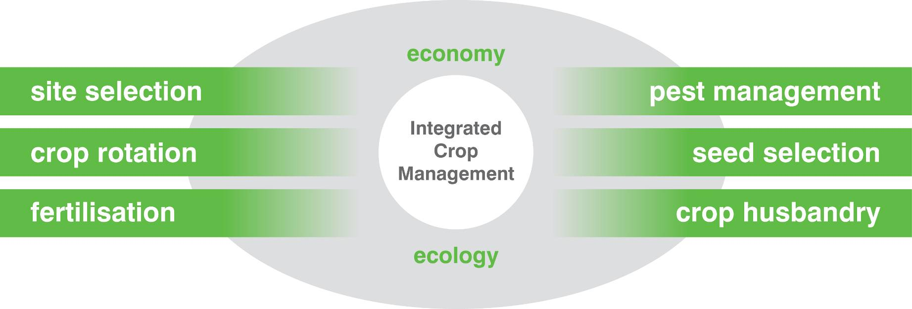
Integrated Crop Management
Healthy plants, people & animals living in a healthy environment
understand interactions between biology, land management and environment
focus on managing crops profitably but with respect for the local conditions
aim to minimize dependency on chemical inputs
integrate production practices to optimize crop health
selection and adaptation to local situation
Notes:
ICM is based on a good understanding of the interactions between biology, environment and land management systems. Above all, it focuses on managing crops profitably but with respect for the environment in ways that suit the local conditions, and as such, economy and ecology (relationship between organisms and the environment) form the backdrop.

Slide 11
The Broader Context
Need for integrated landscape planning to support both development and conservation
Recognize complex system interactions and transboundary issues
Preserve or restore ecosystem services
Protect biodiversity and combat invasive species
Develop new agriculture practices to adapt to climate change
Improve land use planning to adapt to climate impacts

Slide 12
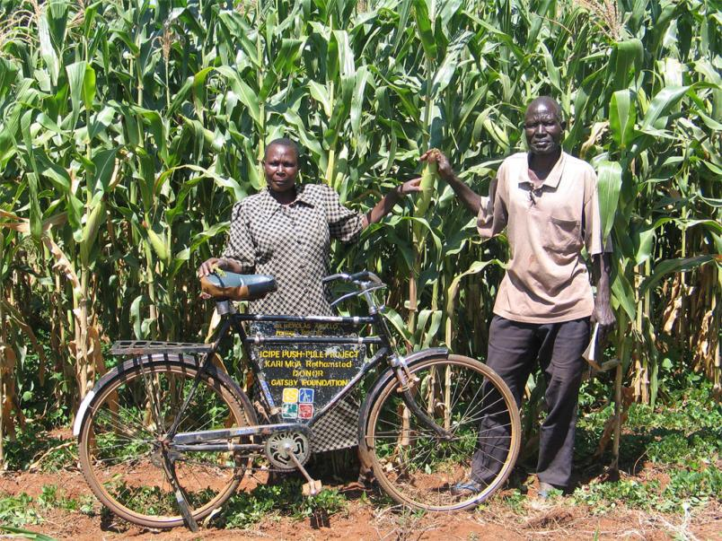
Ensure local support
Communicate widely to gain buy-in of all stakeholder groups
Integrate local knowledge, customs and traditions
Actively involve women and youth
Put research into use packages with simple information support
Provide evidence of impact

Slide 13
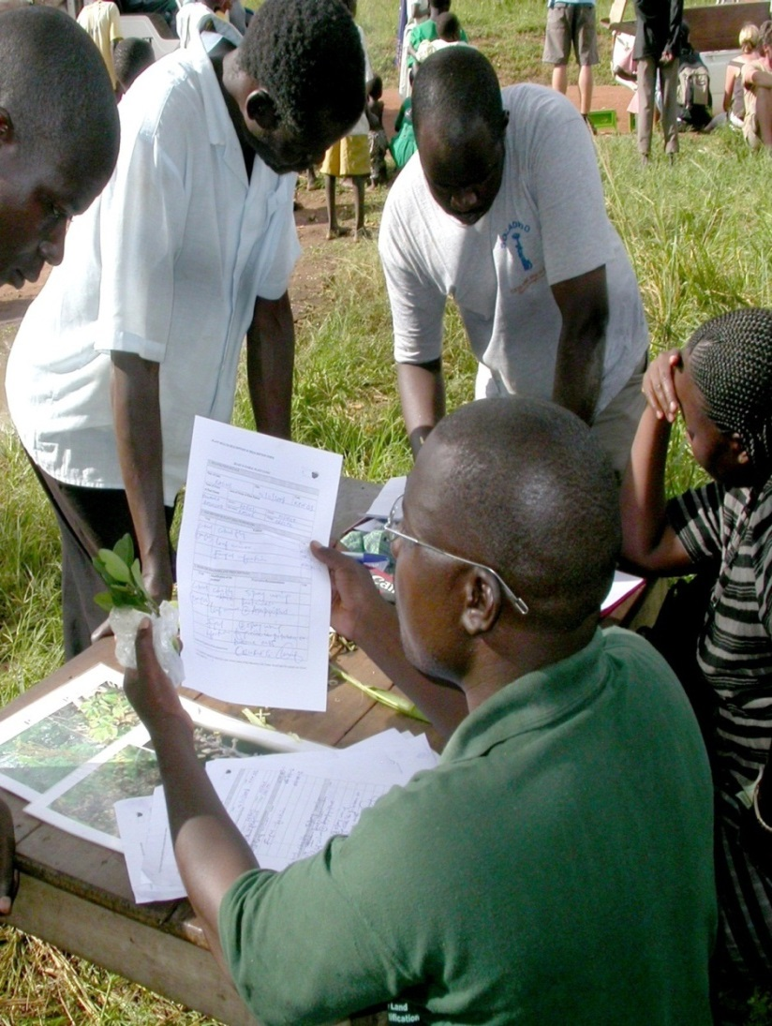
How Governments can help
Joined up policies for agriculture, health and trade
Local, national, regional perspectives
Communications – particularly mobile
Physical access – goods in and out
Access to finance, credit, insurance
Infrastructure, health and education
Stimulate private sector partnerships

Slide 14
More viable communities
Reducing risk
Increasing sustainability
Crop/fertilizer/water mix for better nutrition and yield
Crop types and practices for resilience to change
Improved knowledge of and access to markets
Control of invasive species
Lose less to increase output/ quality with fewer inputs
Protection of biodiversity on and off farm
Management of ecosystem services, practices and use
Involvement of women
Better nutrition, increased incomes, greater opportunity
Improved quality of life, greater social stability

Slide 15
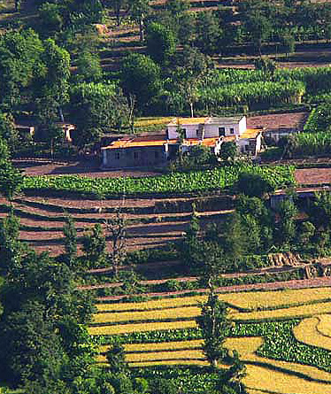
AIRCA members have
Expertise across range of ecosystems & substantive crop diversity
Core competencies in health of humans, plants, animals & landscapes
Integrated & holistic approaches to solving development problems at scale
Ability to respond rapidly & efficiently in the face of new problems
Long-established track record of working with member-country governments, NARS & the private sector
Partnerships with the CGIAR, FAO etc.

Slide 16
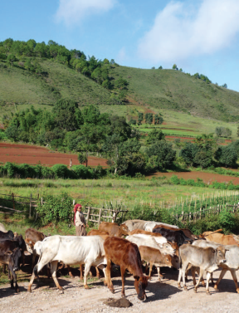
AIRCA’s Vision and Mission
Vision:
Healthy landscapes for improved livelihoods and food security
Mission:
Putting research into use by strengthening capacities for sustainable improvements to incomes, food and nutrition security in healthy landscapes

Slide 17
What can we contribute?
Experience of varied and challenging ecosystems (geography, climate and politics)
Expertise in a wide range of crops
Focus on diverse crops of high economic, nutritional or cultural value
Development of metrics (economics and biology)
Innovative mechanisms for communication, knowledge transfer and capacity building
Creative strategies to assess outcomes and impact

Slide 18
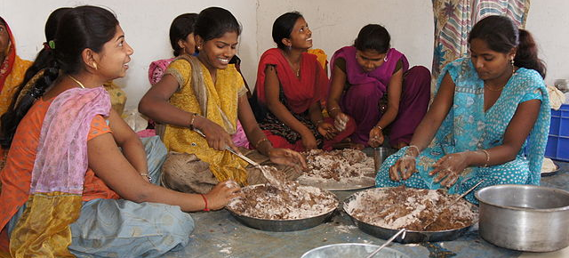
What have we learned (1)?
Food and nutrition security
Indigenous crops and animals are often best suited to the region
New crops and varieties can improve climate resilience or resistance to pests and diseases
Crop/diet diversity essential for nutritional security
Understand culture and tradition around food, not just the calories

Slide 19
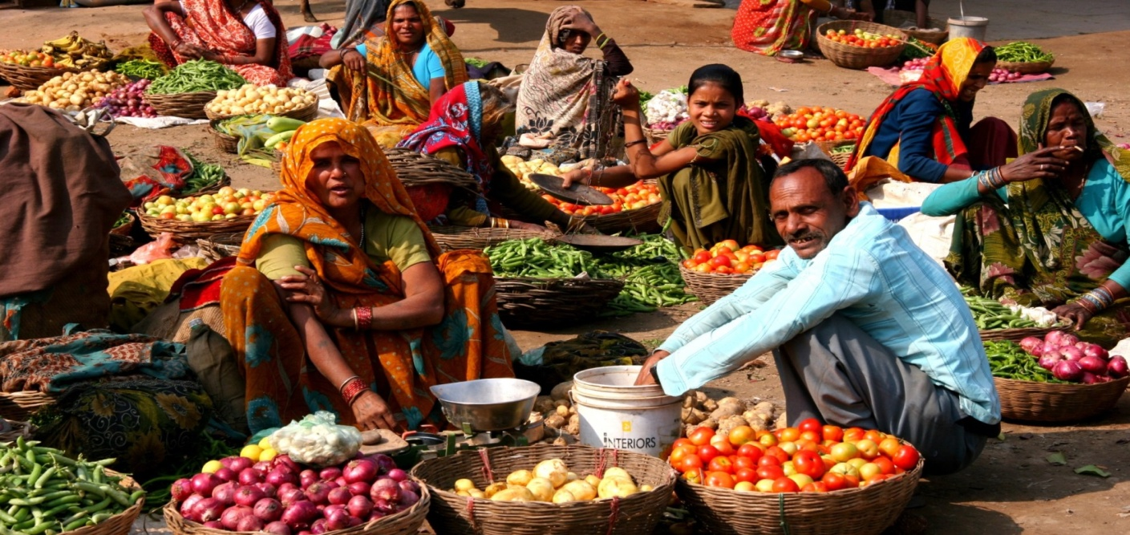
What have we learned (2)
Improving livelihoods
Link farmers to markets, support with information
Improve access to alternative value chains and markets
Help farmers organise, brand and market their crop
Develop agroforestry systems (fruit, coffee, bamboo)
Improve plant health systems and promote IPM approaches
Consider non-farm and off-farm alternatives

Slide 20
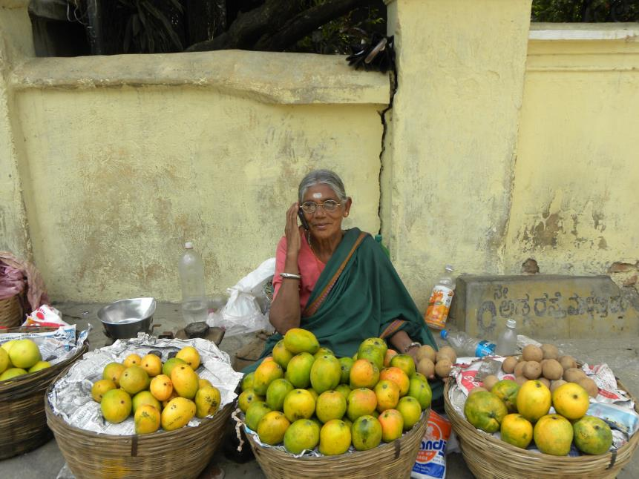
What have we learned (3)?
Leveraging the power of mobile
More Efficiency: $1.13 vs $8.50/farmer
(mobile vs. physical extension)
Greater reach, broader coverage
  Weather
  Alerts, early warning
  Market prices, locations
  Best practice advice
  Crop health, pests and disease
  Input supplies
  Animal health and husbandry
  Crop Calendar-based advice
  Finance, credit and insurance
  Nutrition
  Health

